Slide 1

Unit – 2 Probability
Probability & Statistics (PS)
DU # 2301HS402
Prof. Vasudev Barjadiya
Department of Humanities & Science
vasudev.barjadiya@darshan.ac.in
901 64 27 400

Slide 2

Looping
Topics of Unit 2
Counting
Basic Terminologies and Results on Probability
Conditional Probability and Independent Events
Bayes’ Theorem
Random Variables and Probability Function
Various Measures of Statics
Cumulative Distribution Function and its Properties.

Slide 3

Looping
Outline of Unit 2
Counting
Permutation and Combination
Basic Terminologies and Results on Probability
Basic Terminologies
Probability of an Event
Conditional Probability and Independent Events
Conditional Probability
Multiplicative Law of Probability
Independent & Mutually Independent Events

Slide 4

Looping
Outline of Unit 2
Bayes’ Theorem
Total Probability
Bayes’ Theorem
Random Variables and Probability Function
Discrete & Continuous Random Variable
Probability Distribution of random variable
Probability Mass Function & Probability Density Function

Slide 5

Looping
Outline of Unit 2
Various Measures of Statics
Mathematical Expectation
Variance of Random Variable
Standard Deviation of Random Variable
Cumulative Distribution Function and its Properties

Slide 6
Introduction
Probability theory is the branch of mathematics that is concerned with random (or chance) phenomena. It has attracted people to its study both because of its intrinsic interest and its successful applications to many areas within the physical, biological, social sciences, in engineering and in the business world.
The words probable and possible chances are quite familiar to us. We use these words when we are sure of the result of certain events. These words convey the sense of uncertainty of occurrence of events.

Slide 7
Introduction
Probability allows computer scientists to handle the inherent uncertainty in computational systems and real-world data.
It helps us make informed decisions, analyse risks, and predict outcomes based on available information.
Probability is the word we use to calculate the degree of the certainty of events.
There are two types of approaches in the theory of Probability:
Classical Approach – By Blaise Pascal
Axiomatic Approach – By A. Kolmogorov

Slide 8
Method 1 Counting

Slide 9
Factorial
The product of the first $n$ positive integers is known as ‘$n$ factorial’.
It is denoted by $n!$
i.e., $n!=1×2×3×…×\left(n−1\right)×n$
For example:
$5!$
Some important results:
$n!=n⋅\left(n−1\right)!$
$0!$
$$=5×4×3×2×1$$
$$=120$$
$$=1$$

Slide 10
Permutation (Arrangement)
A permutation is an arrangement in a definite order of a number of objects taken some or all at a time.
Suppose that we are given ‘$n$’ distinct objects and wish to arrange ‘$r$’ of these objects in a line without repeating. $\left(0≤r≤n\right)$
An ordered arrangement of $r$ elements of a set is known as $r$– permutation.
It is denoted by ${{}_{ }^{n}P}_{r}$ or $_{n}P_{r}$ or $P\left(n,r\right)$.
Total number of permutation (arrangements) can be calculated as follow:
$$P\left(n, r\right)={{}_{ }^{n}P}_{r}=\frac{n!}{ \left(n−r\right)! }$$

Slide 11
Permutation (Arrangement)
For example:
A number of $3$ lettered words which can be formed by without repeating letters of the word “NUMBER” is,
$$P\left(5, 3\right)={{}_{ }^{6}P}_{3}\frac{5!}{ \left(5−3\right)! }=60$$
$$=\frac{6!}{ \left(6−3\right)! }$$
$$=120$$

Slide 12
Permutation (Arrangement)
Some important results
${{}_{ }^{n}P}_{n}=n!$
${{}_{ }^{n}P}_{0}=1$
When all the objects are distinct, the number of permutations with repeating the object is given by $n^{r}$.
For example:
A number of $3$ lettered words which can be formed by repeating letters of the word “NUMBER” is
$$6^{3}=216.$$

Slide 13
Permutation (Arrangement)
Some important results
When all the objects are not distinct, the number of permutations of $n$ object in which $n_{1}$ are of one kind, $n_{2}$ are of second kind, …, and $n_{k}$ are of $k^{th}$ kind is given by,
$$\frac{n! }{n_{1}! n_{2}! … n_{k}! }.$$
Note that, $n=n_{1}+n_{2}+⋯+n_{k}.$

Slide 14
Permutation (Arrangement)
Some important results
For example:
The number of different permutations of the letters in the word "MISSISSIPPI" is calculated as follows:
There are $11$ total letters, where M occurs $1$ time, I and S each occur $4$ times, and P occurs $2$ times.
$$\frac{ 11! }{ 1! 4! 4! 2! }=34650$$

Slide 15
Combination
Combinations are selections of objects without regard to the order.
Suppose that we are given ‘$n$’ distinct objects and wish to select ‘$r$’ of these objects without repetition. $\left(0≤r≤n\right)$
An Selection $r$ elements of a set is known as $r$– combination.
Total number of combinations (selections) can be calculated as follow:
$$C\left(n, r\right)={{}_{ }^{n}C}_{r}=\left(\begin{aligned}\begin{aligned} \\ {n \atop r} \end{aligned} \\ \end{aligned}\right)=\frac{n!}{ r!\left(n−r\right)! }$$

Slide 16
Combination
For example:
The number of ways in which 3 card can be chosen from $8$ cards is
$$\left(\begin{aligned} \\ {8 \atop 3} \\ \end{aligned}\right)=\frac{ 8! }{3!\left(8−3\right)! }=\frac{ 8×7×6 }{3×2×1 }=56$$
A club has 10 male and 8 female members. A committee composed of 3 men and 4 women is formed. In how many ways this can be done?
$$\left(\begin{aligned} \\ {10 \atop 3} \\ \end{aligned}\right)\left(\begin{aligned} \\ {8 \atop 4} \\ \end{aligned}\right)=120×70=8400$$

Slide 17
Combination
For example:
Out of 6 boys and 4 girls, in how many ways a committee of five members can be formed in which there are at most 2 girls are included?
$$\left(\begin{aligned} \\ {4 \atop 2} \\ \end{aligned}\right)\left(\begin{aligned} \\ {6 \atop 3} \\ \end{aligned}\right)+\left(\begin{aligned} \\ {4 \atop 1} \\ \end{aligned}\right)\left(\begin{aligned} \\ {6 \atop 4} \\ \end{aligned}\right)+\left(\begin{aligned} \\ {4 \atop 0} \\ \end{aligned}\right)\left(\begin{aligned} \\ {6 \atop 5} \\ \end{aligned}\right)=120+60+6=186$$

Slide 18
Combination
Some important results
${{}_{ }^{n}C}_{0}={{}_{ }^{n}C}_{n}=1$
${{}_{ }^{n}C}_{1}=n$
${{}_{ }^{n}C}_{k}={{}_{ }^{n}C}_{n−k}$

Slide 19
Examples of Method 1
Counting

Slide 20
Method 1 ⇝ Example 1
How many words, with or without meaning can be made from the letters of the word “MONDAY”, assuming that no letter is repeated, if
4 – letters are used at a time
(1)
,
(2)
,
All letters are used at a time
(3)
All letters are used but the first letter is vowel
?
Solution:
There are $6$ letters in word “MONDAY”
$$∴$$
$$n=6$$
Note that, in given word
there are
($2$ vowels)
Keeping in mind that no letter is repeated

Slide 21
Method 1 ⇝ Example 1 (Continue)
There are $6$ letters in word “MONDAY”
($2$ vowels)
$$∴$$
$$n=6$$
Keeping in mind that no letter is repeated
(1)
4 – letters are used at a time
(2)
All letters are used at a time
$$∴$$
$$r=4$$
$$∴$$
$$r=6$$
$$=\frac{6!}{ 2! }$$
$$∴$$
$${{}_{ }^{6}P}_{4}$$
$$∴$$
$${{}_{ }^{6}P}_{6}$$
$$=6!$$
$$=360$$
$$=720$$
$360$ words can be formed if 4 letters are used at a time
$720$ words can be formed if all letters are used at a time
(3)
All letters are used but the first letter is vowel

Slide 22

Method 1 ⇝ Example 1 (Continue)
There are $6$ letters in word “MONDAY”
($2$ vowels)
$$∴$$
$$n=6$$
1 letter is used
5 letters and 5 places left
Keeping in mind that no letter is repeated
(3)
All letters are used but the first letter is vowel
$${{}_{ }^{2}P}_{1}$$
$$×$$
$${{}_{ }^{5}P}_{5}$$
$$=$$
$$2$$
$$×$$
$$120$$
$$=$$
$$240$$
$240$ words can be formed if all letters are used at a time and word starts with vowel.

Slide 23
Method 1 ⇝ Example 2
How many different poker hands consists of $5$ cards being either $2$ or $7$?
Solution:
No. of different poker hands
$$=$$
$${}_{ }^{4}{C_{4}}$$
$$×$$
$${}_{ }^{4}{C_{1}}$$
$$+$$
$${}_{ }^{4}{C_{3}}$$
$$×$$
$${}_{ }^{4}{C_{2}}$$
$$+$$
$${}_{ }^{4}{C_{2}}$$
$$×$$
$${}_{ }^{4}{C_{3}}$$
$$+$$
$${}_{ }^{4}{C_{1}}$$
$$×$$
$${}_{ }^{4}{C_{4}}$$
$$=$$
$$1$$
$$×$$
$$4$$
$$+$$
$$4$$
$$×$$
$$6$$
$$+$$
$$6$$
$$×$$
$$4$$
$$+$$
$$4$$
$$×$$
$$1$$
$$=$$
$$4$$
$$+$$
$$24$$
$$+$$
$$24$$
$$+$$
$$4$$
No. of $2$s In poker hand | No. of $7$s In poker hand
$$=$$
$$56$$
$$4$$
$$1$$
$$3$$
$$2$$
$$2$$
$$3$$
$$1$$
$$4$$

Slide 24
Method 1 ⇝ Example 3
A bag contains $5$ black ball and $6$ red balls. Determine the number of ways in which $2$ black and $3$red balls can be selected.
Solution:
A Bag contains
$5$ black
balls
$$+$$
$6$ red
balls
$$=$$
$11$ balls
Number of ways in which $2$ black and $3$red balls can be selected
$$=$$
$${}_{ }^{5}{C_{2}}$$
$$×$$
$${}_{ }^{6}{C_{3}}$$
$$=$$
$$10$$
$$×$$
$$20$$
$$=$$
$$200$$

Slide 25
Method 1 ⇝ Example 4
What is the number of ways of choosing $4$ cards of below choices from pack of $52$ cards?
(1)
All four cards are from the same suit
(2)
All four cards are from different suits
(3)
Two cards are red and two cards are black
Solution:
(1)
All four cards are from the same suit
A deck has $4$ suits
(Spades, Hearts, Diamonds, Clubs)
and each suit has $13$ cards
$4$ Spades selected
$4$ Hearts selected
$4$ Diamonds selected
$4$ Clubs selected
or
or
or

Slide 26
Method 1 ⇝ Example 4 (Continue)
(1)
All four cards are from the same suit
$4$ Spades selected
$4$ Hearts selected
$4$ Diamonds selected
$4$ Clubs selected
or
or
or
No. of ways of choosing $4$ cards of same suit
$$=$$
$${}_{ }^{13}{C_{4}}$$
$$+$$
$${}_{ }^{13}{C_{4}}$$
$$+$$
$${}_{ }^{13}{C_{4}}$$
$$+$$
$${}_{ }^{13}{C_{4}}$$
$$=$$
$$4$$
$$×$$
$${}_{ }^{13}{C_{4}}$$
$$=$$
$$4$$
$$×$$
$$715$$
$$=$$
$$2860$$
(2)
All four cards are from different suits
(3)
Two cards are red and two cards are black

Slide 27
Method 1 ⇝ Example 4 (Continue)
(2)
All four cards are from different suits
$1$ Spades selected
$1$ Hearts selected
$1$ Diamonds selected
$1$ Clubs selected
and
and
and
No. of ways of choosing cards of different suits
$$=$$
$${}_{ }^{13}{C_{1}}$$
$$×$$
$${}_{ }^{13}{C_{1}}$$
$$×$$
$${}_{ }^{13}{C_{1}}$$
$$×$$
$${}_{ }^{13}{C_{1}}$$
$$=$$
$${\left( \right)}^{4}$$
$${}_{ }^{13}{C_{1}}$$
$$=$$
$$2860$$
(3)
Two cards are red and two cards are black

Slide 28
Method 1 ⇝ Example 4 (Continue)
(3)
Two cards are red and two cards are black
A deck has
$26$ red cards
and
$26$ black cards
$2$ red card selected
$2$ black card selected
and
No. of ways of choosing $2$ red and $2$ black cards
$$=$$
$${}_{ }^{26}{C_{2}}$$
$$×$$
$${}_{ }^{26}{C_{2}}$$
$$=$$
$${\left( \right)}^{2}$$
$$325$$
$$=$$
$$105625$$

Slide 29
Method 2.1 Basic Terminologies

Slide 30
Random Experiment
An experiment conducted under identical conditions is known as random experiment if it satisfies the following conditions:
It has more than one possible outcome.
It is not possible to predict the outcome in advance.
For example:
Tossing a coin is random experiment.
Throwing/rolling a die is random experiment.
Selecting a card from a pack of playing cards is random experiment.
Dividing $36$ by $4$ using a calculator is not random experiment.

Slide 31

Sample Space
The set of all possible outcome is known as sample space of a random experiment.
Sample space is denoted by the symbol $S$.
Elements of a sample space is known as sample points.
The sample space of an experiment may finite or infinite.
For example:
Consider an experiment of tossing a coin.
The outcomes of this experiment are $head \left(H\right)$ or $tail \left(T\right).$
Therefore, sample space of this experiment is written as follow:
$$S=\left\{ H, T \right\}$$

Slide 32

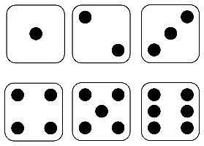
Sample Space
For example:
Consider an experiment of rolling a die.
The outcomes of this experiment are
Therefore, sample space of this experiment is written as follow:
$$S=\left\{ 1, 2, 3, 4, 5, 6 \right\}$$
$1, 2, 3, 4, 5$ or $6.$

Slide 33
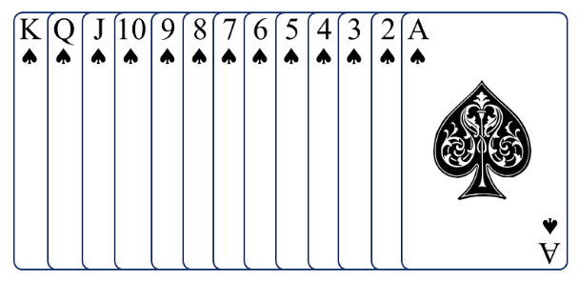
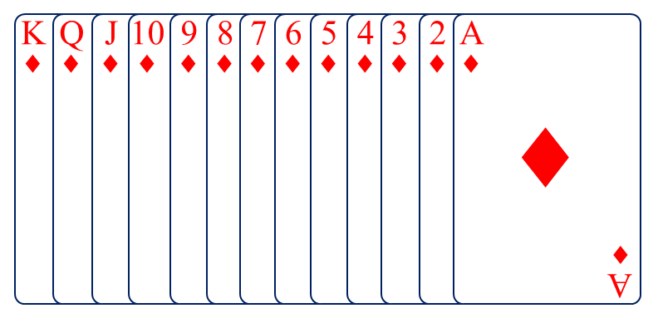
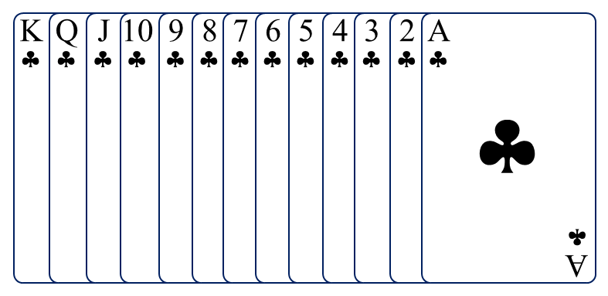
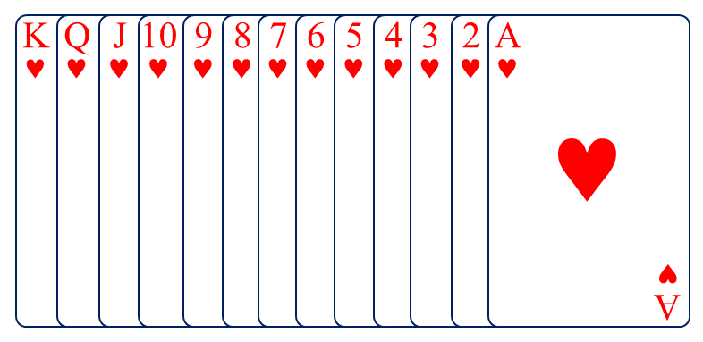
Sample Space
Deck of 52 playing cards which has four suits as follow:
$$\text{}$$
$$\text{◻}$$
$$Spades$$
$$Diamond$$
$$\text{▪}$$
$$\text{}$$
$$Club$$
$$Heart$$

Slide 34
Sample Space
♠
♦
♥
♣
52 cards
♠♣
♥♦
Black
Red
26 cards
26 cards
♠
♣
♥
♦
13 cards
13 cards
13 cards
13 cards

Slide 35
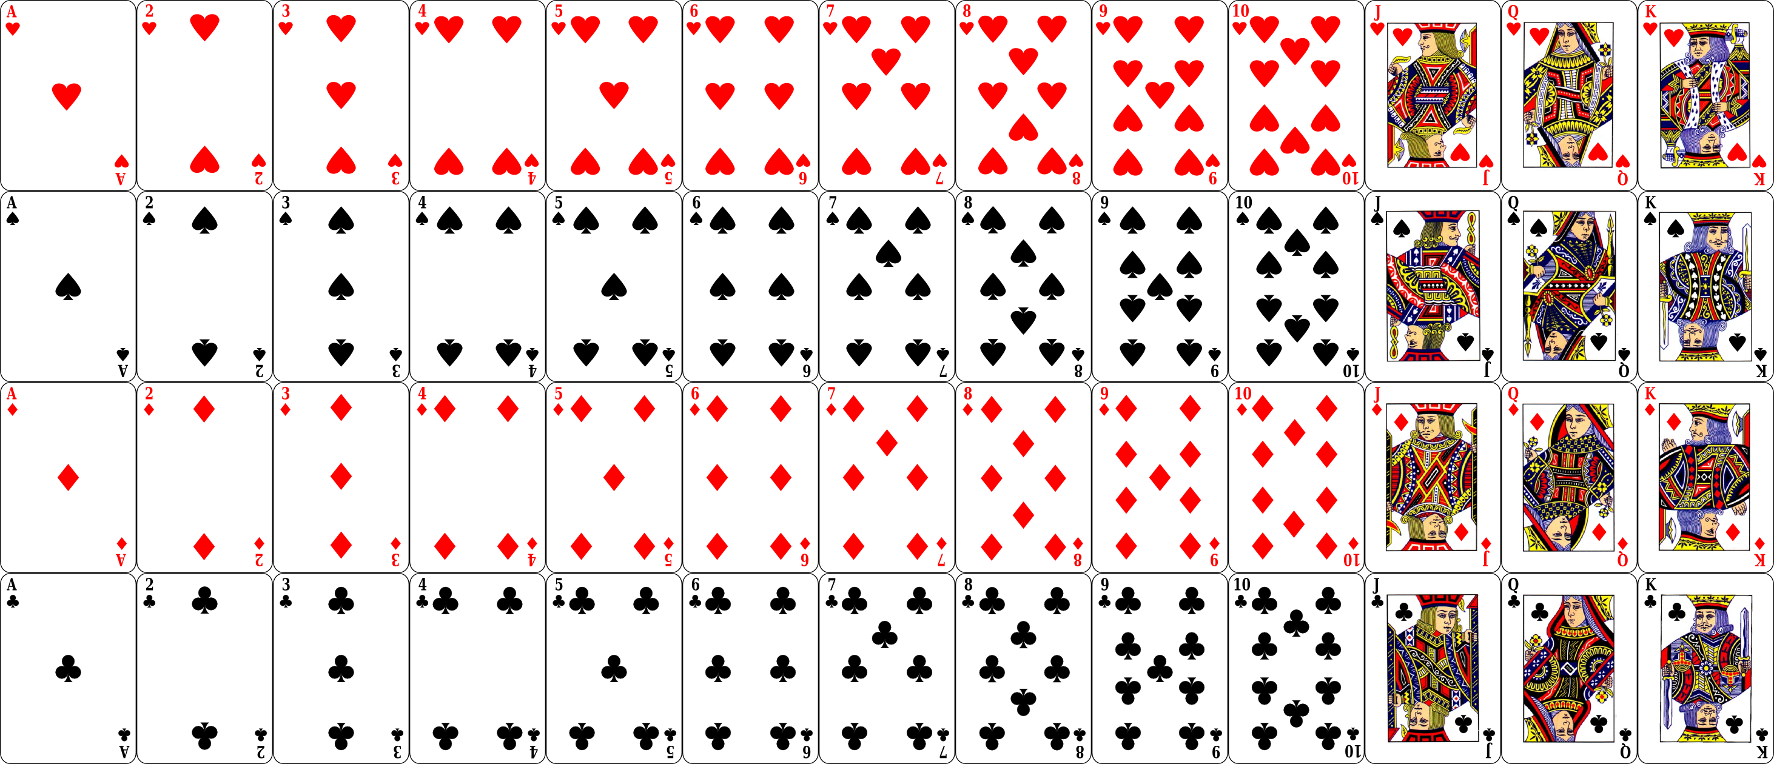

Sample Space
Picture cards
(12)
A
♠
Ace
A
♠
King
Queen
Jack

Slide 36
Types of Experiments
Experiment with Replacement
You select something from sample, put it back and then select again.
Each selection is independent and the size of the sample remains constant throughout the experiment.
Experiment without Replacement
You select something from sample, don't put it back and then select again.
Each selection affects the subsequent selections, they are dependent on previous ones and size of a sample space is reduced after each selection.

Slide 37
Event
Any subset of a sample space is known as an event.
For example:
In experiment of Rolling a six-sided die and observing the number (or dots) that appear on top.
A sample space of an experiment is
Event $A$ : even number appears on top.
Event $B$ : non-prime number appears on top.
Event $C$ : number $7$ appears on top.
Event $D$ : number less than $7$ appears on top.
$$S$$
$$=\left\{ 1, 2, 3, 4, 5, 6 \right\}.$$
$$A$$
$$=\left\{ 2, 4, 6 \right\}$$
$$B$$
$$=\left\{ 1, 4, 6 \right\}$$
$$C$$
$$=ϕ$$
$$D$$
$$=\left\{ 1, 2, 3, 4, 5, 6 \right\}$$
$$=S$$

Slide 38
Types of Events
Impossible Event
The event $E$ is known as impossible event if $E=φ$.
In previous example, event $C=ϕ$ therefore it is impossible event.
Sure Event
The event $E$ is known as sure event if $E=S$.
In previous example, event $D=S$ therefore it is sure event.

Slide 39
Types of Events
Simple or Elementary Event
If an event $E$ has only one sample point of a sample space, then it is known as a simple (or elementary) event.
For example:
For experiment of tossing two coins, a sample space is
$$S=\left\{ HH, HT, TH, TT \right\}$$
$E_{1}=\left\{ HH \right\}, E_{2}=\left\{ HT \right\}, E_{3}=\left\{ TH \right\}$ & $E_{4}=\left\{ TT \right\}$ are simple events.

Slide 40
Types of Events
Compound Event
If an event $E$ has more than one sample point of a sample space, then it is known as a compound event.
For example:
For experiment of tossing a coin thrice, a sample space is
$$S=\left\{ HHH, HHT, HTH, HTT, THH, THT, TTH, TTT \right\}$$
Event $A$ : Exactly one head appeared
Event $B$ : At least two tails appeared
Here, events $A$ and $B$ are compound events.
$$A$$
$$=\left\{ HTT, THT, TTH \right\}$$
$$B$$
$$=\left\{ HTT, THT, TTH, TTT \right\}$$

Slide 41
Types of Events
Complementary Event
For every event $E$, there corresponds another event $E^{′} \left(or \overline{E} \right)$ known as the complementary event to $E$.
Which is defined as $E^{′}=S−E$.
It is also known as the event “not $E$”.

Slide 42
Types of Events
Complementary Event
For example:
For experiment of tossing a coin thrice, a sample space is
$$S=\left\{ HHH, HHT, HTH, HTT, THH, THT, TTH, TTT \right\}$$
Event $A$ : Exactly one head appeared
The complementary event corresponds to event $A$ is as follow:
$$A$$
$$=\left\{ HTT, THT, TTH \right\}$$
$$A^{′}$$
$$=\left\{ HHH, HHT, HTH, THH, TTT \right\}$$

Slide 43
Types of Events
Mutually Exclusive Event
Events $A$ and $B$ are known as mutually exclusive even if $A∩B=φ$.
For example:
For experiment of throwing a die, a sample space is
$$S=\left\{ 1, 2, 3, 4, 5, 6 \right\}$$
$A=\left\{ 2, 4, 6 \right\}, B=\left\{ 1, 3, 5 \right\}, C=\left\{ 2, 3, 5 \right\}$ be events.
$$A∩B$$
$$=φ$$
$$B∩C$$
$$=\left\{ 3, 5 \right\}$$
$$≠φ$$
Events $A$ and $B$ are mutually exclusive events.
Events $B$ and $C$ are not mutually exclusive events.

Slide 44
Types of Events
Exhaustive Events
Events $E_{1}, E_{2}, …, E_{n}$ of a sample space $S$ are known as exhaustive events, if
$$\bigcup_{i=1}^{n}{ E_{i}}=E_{1}∪E_{2}∪…∪E_{n}=S$$

Slide 45
Types of Events
Exhaustive Events
For example:
In experiment of rolling a die, $S=\left\{ 1, 2, 3, 4, 5, 6 \right\}$.
Let Event $A$ : A number less than $4$ appears $⇒A=\left\{ 1, 2, 3 \right\}$
Event $B$ : A number greater than $2$ but less than $5$ appears $⇒B=\left\{ 3, 4 \right\}$
Event $C$ : A number greater than $4$ appears $⇒C=\left\{ 5, 6 \right\}$
Now,
$$A∪B∪C=\left\{ 1, 2, 3 \right\}∪\left\{ 3, 4 \right\}∪\left\{ 5, 6 \right\}$$
$$=\left\{ 1, 2, 3, 4, 5, 6 \right\}=S$$
Hence, events $A$, $B$and $C$ are exhaustive events.

Slide 46
Types of Events
Furthermore, if
$E_{i}∩E_{j}=φ$ for $i≠j$ and
$$\bigcup_{i=1}^{n}{ E_{i}}=S,$$
then events $E_{1}, E_{2}, …, E_{n}$ are known as mutually exclusive and exhaustive events.

Slide 47
Examples of Method 2.1
Basic Terminologies

Slide 48
Method 2.1 ⇝ Example 1
A coin is tossed twice, and their up faces are recorded. What is the sample space for this experiment?
Solution:
$$S$$
$=\left\{ HH, HT, TH, TT \right\}$
$$HH,$$
$$HT,$$
$$TH,$$
$$TT$$
Coin 1 | Coin 2
H
H
H
T
T
H
T
T

Slide 49
Method 2.1 ⇝ Example 2
Find the sample space associated with the experiment of rolling a pair of dice once. Also, find the number of elements of this sample space.
Solution:
$$\left( 1, 1 \right), \left( 1, 2 \right), \left( 1, 3 \right), \left( 1, 4 \right), \left( 1, 5 \right), \left( 1, 6 \right)$$
$$\left( 2, 1 \right), \left( 2, 2 \right), \left( 2, 3 \right), \left( 2, 4 \right), \left( 2, 5 \right), \left( 2, 6 \right)$$
$$\left( 3, 1 \right), \left( 3, 2 \right), \left( 3, 3 \right), \left( 3, 4 \right), \left( 3, 5 \right), \left( 3, 6 \right)$$
$$S$$
$$=$$
$$\left( 4, 1 \right), \left( 4, 2 \right), \left( 4, 3 \right), \left( 4, 4 \right), \left( 4, 5 \right), \left( 4, 6 \right)$$
$$\left( 5, 1 \right), \left( 5, 2 \right), \left( 5, 3 \right), \left( 5, 4 \right), \left( 5, 5 \right), \left( 5, 6 \right)$$
$$\left( 6, 1 \right), \left( 6, 2 \right), \left( 6, 3 \right), \left( 6, 4 \right), \left( 6, 5 \right), \left( 6, 6 \right)$$
Number of elements in sample space
$$=6×6=6^{2}=36$$

Slide 50















Method 2.1 ⇝ Example 3
A coin is tossed. If it shows head, we draw a ball from a bag which contains $3$ blue and $4$ white balls; if it shows tail, we throw a die. Describe the sample space of this experiment.
Solution:
$$=\left\{ \begin{matrix} \\ \left( 1, 1 \right), \left( 1, 2 \right), \left( 1, 3 \right), \left( 1, 4 \right), \left( 1, 5 \right), \\ \left( 2, 1 \right), \left( 2, 2 \right), \left( 2, 3 \right), \left( 2, 4 \right), \left( 2, 5 \right), \\ \end{matrix} \right\}$$
$$HB_{1},$$
$$HB_{2},$$
$$HB_{3},$$
$$HW_{1},$$
$$HW_{2},$$
$$HW_{3},$$
$$HW_{4},$$
$$S$$
$$T1,$$
$$T2,$$
$$T3,$$
$$T4,$$
$$T5,$$
$$T6$$

Slide 51
































Method 2.1 ⇝ Example 4
The letters A, B, C and D are written separately on four slips of paper. The slips are put in a box and mixed thoroughly. A person draws two slips from the box, one after the other. Describe the sample space for the experiment in following cases:
(1) With replacement (2) Without replacement
Solution:
(1) With replacement
(2) Without replacement
$$=\left\{\begin{matrix} \\ \left( 1, 2 \right), \left( 1, 3 \right), \left( 1, 4 \right), \\ \left( 2, 1 \right), \left( 2, 2 \right), , \left( 2, 4 \right) \\ \left( 2, 2 \right), \\ \\ \end{matrix}\right\}$$
$$=\left\{ \begin{matrix} \\ \left( 1, 2 \right)\left( 1, 4 \right), \\ \left( 2, 1 \right), \left( 2, 4 \right) \\ \left( 2, 2 \right), \\ \\ \end{matrix}\right\}$$
$$AA,$$
$$AB,$$
$$AC,$$
$$AD,$$
$$AB,$$
$$AC,$$
$$AD,$$
$$BA,$$
$$BB,$$
$$BC,$$
$$BD,$$
$$BA,$$
$$BC,$$
$$BD,$$
$$S_{1}$$
$$S_{2}$$
$$CA,$$
$$CB,$$
$$CC,$$
$$CD,$$
$$CA,$$
$$CB,$$
$$CD,$$
$$DA,$$
$$DB,$$
$$DC,$$
$$DD$$
$$DA,$$
$$DB,$$
$$DC$$

Slide 52


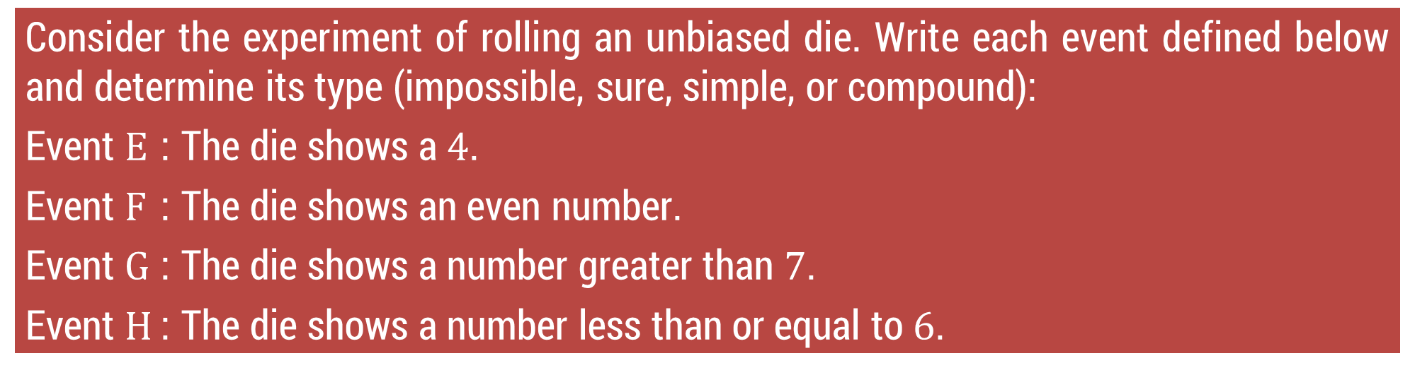








Method 2.1 ⇝ Example 5
Consider the experiment of rolling an unbiased die. Write each event defined below and determine its type (impossible, sure, simple, or compound):
Event $E$ : The die shows a $4$.
Event $F$ : The die shows an even number.
Event $G$ : The die shows a number greater than $7$.
Event $H$ : The die shows a number less than or equal to $6$.
Solution:
$$S=\left\{ 1, 2, 3, 4, 5, 6 \right\}$$
$$E=$$
$$\left\{ 4 \right\}$$
Simple event
$$F=$$
$$\left\{ 2, 4, 6 \right\}$$
Compound event
$$G=$$
$$ϕ$$
Impossible event
$$H=$$
$$\left\{ 1, 2, 3, 4, 5, 6 \right\}$$
$$=S$$
Sure event

Slide 53


Method 2.1 ⇝ Example 6
Two unbiased dice are thrown. Write down the following events:
Event $A$ : Both the dice show the same number.
Event $B$ : The sum of the numbers on the dice is $8$.
Event $C$ : The sum of the number on the dice is any number from $2$ to $6$.
Event $D$ : The sum of the numbers on the dice is $13$.
Solution:
$$\left( 1, 1 \right), \left( 1, 2 \right), \left( 1, 3 \right), \left( 1, 4 \right), \left( 1, 5 \right), \left( 1, 6 \right)$$
$$\left( 2, 1 \right), \left( 2, 2 \right), \left( 2, 3 \right), \left( 2, 4 \right), \left( 2, 5 \right), \left( 2, 6 \right)$$
$$\left( 3, 1 \right), \left( 3, 2 \right), \left( 3, 3 \right), \left( 3, 4 \right), \left( 3, 5 \right), \left( 3, 6 \right)$$
$$S$$
$$=$$
$$\left( 4, 1 \right), \left( 4, 2 \right), \left( 4, 3 \right), \left( 4, 4 \right), \left( 4, 5 \right), \left( 4, 6 \right)$$
$$\left( 5, 1 \right), \left( 5, 2 \right), \left( 5, 3 \right), \left( 5, 4 \right), \left( 5, 5 \right), \left( 5, 6 \right)$$
$$\left( 6, 1 \right), \left( 6, 2 \right), \left( 6, 3 \right), \left( 6, 4 \right), \left( 6, 5 \right), \left( 6, 6 \right)$$

Slide 54



Method 2.1 ⇝ Example 6 (Continue)
$$\left( 1, 1 \right), \left( 1, 2 \right), \left( 1, 3 \right), \left( 1, 4 \right), \left( 1, 5 \right), \left( 1, 6 \right)$$
$$\left( 2, 1 \right), \left( 2, 2 \right), \left( 2, 3 \right), \left( 2, 4 \right), \left( 2, 5 \right), \left( 2, 6 \right)$$
$$\left( 3, 1 \right), \left( 3, 2 \right), \left( 3, 3 \right), \left( 3, 4 \right), \left( 3, 5 \right), \left( 3, 6 \right)$$
$$S$$
$$=$$
$$\left( 4, 1 \right), \left( 4, 2 \right), \left( 4, 3 \right), \left( 4, 4 \right), \left( 4, 5 \right), \left( 4, 6 \right)$$
$$\left( 5, 1 \right), \left( 5, 2 \right), \left( 5, 3 \right), \left( 5, 4 \right), \left( 5, 5 \right), \left( 5, 6 \right)$$
$$\left( 6, 1 \right), \left( 6, 2 \right), \left( 6, 3 \right), \left( 6, 4 \right), \left( 6, 5 \right), \left( 6, 6 \right)$$
Event $A$ : Both the dice show the same number.
$$A= \left\{ \left( 1, 1 \right), \left( 2, 2 \right), \left( 3, 3 \right), \left( 4, 4 \right), \left( 5, 5 \right), \left( 6, 6 \right) \right\}$$
Event $B$ : The sum of the numbers on the dice is $8$.
$$B= \left\{ \left( 2, 6 \right), \left( 3, 5 \right), \left( 4, 4 \right), \left( 5, 3 \right), \left( 6, 2 \right) \right\}$$
Event $C$ : The sum of the number on the dice is any number from $2$ to $6$.
Event $D$ : The sum of the numbers on the dice is $13$.

Slide 55


Method 2.1 ⇝ Example 6 (Continue)
$$\left( 1, 1 \right), \left( 1, 2 \right), \left( 1, 3 \right), \left( 1, 4 \right), \left( 1, 5 \right), \left( 1, 6 \right)$$
$$\left( 2, 1 \right), \left( 2, 2 \right), \left( 2, 3 \right), \left( 2, 4 \right), \left( 2, 5 \right), \left( 2, 6 \right)$$
$$\left( 3, 1 \right), \left( 3, 2 \right), \left( 3, 3 \right), \left( 3, 4 \right), \left( 3, 5 \right), \left( 3, 6 \right)$$
$$S$$
$$=$$
$$\left( 4, 1 \right), \left( 4, 2 \right), \left( 4, 3 \right), \left( 4, 4 \right), \left( 4, 5 \right), \left( 4, 6 \right)$$
$$\left( 5, 1 \right), \left( 5, 2 \right), \left( 5, 3 \right), \left( 5, 4 \right), \left( 5, 5 \right), \left( 5, 6 \right)$$
$$\left( 6, 1 \right), \left( 6, 2 \right), \left( 6, 3 \right), \left( 6, 4 \right), \left( 6, 5 \right), \left( 6, 6 \right)$$
Event $C$ : The sum of the number on the dice is any number from $2$ to $6$.
$$C=\left\{ \begin{matrix} \\ \left( 1, 1 \right), \left( 1, 2 \right), \left( 1, 3 \right), \left( 1, 4 \right), \left( 1, 5 \right), \\ \left( 2, 1 \right), \left( 2, 2 \right), \left( 2, 3 \right), \left( 2, 4 \right), \left( 3, 1 \right), \\ \left( 3, 2 \right), \left( 3, 3 \right), \left( 4, 1 \right), \left( 4, 2 \right), \left( 5, 1 \right) \\ \end{matrix}\right\}$$
$$\left( 1, 1 \right), \left( 1, 2 \right), \left( 1, 3 \right), \left( 1, 4 \right), \left( 1, 5 \right),$$
$$\left( 2, 1 \right), \left( 2, 2 \right), \left( 2, 3 \right), \left( 2, 4 \right), \left( 3, 1 \right),$$
$$\left( 3, 2 \right), \left( 3, 3 \right), \left( 4, 1 \right), \left( 4, 2 \right), \left( 5, 1 \right)$$
Event $D$ : The sum of the numbers on the dice is $13$.
$$D=ϕ$$

Slide 56








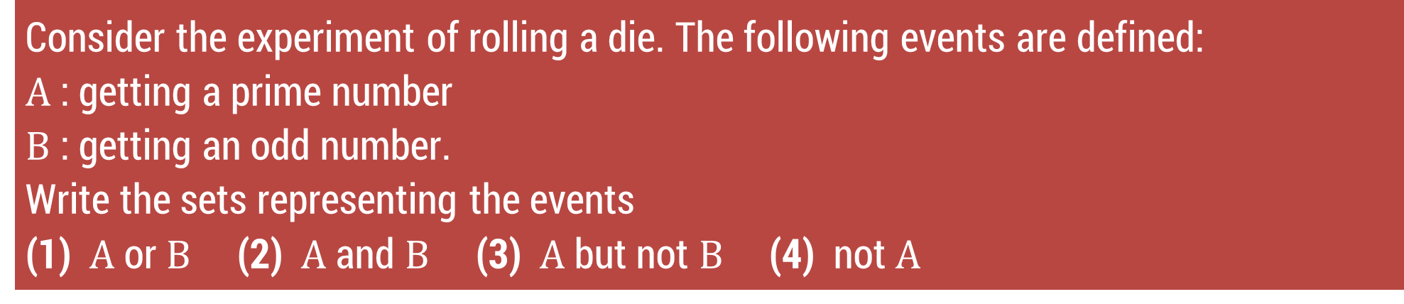











Method 2.1 ⇝ Example 7
Consider the experiment of rolling a die. The following events are defined:
$A$ : getting a prime number
$B$ : getting an odd number.
Write the sets representing the events
(1) $A$ or $B$ (2) $A$ and $B$ (3) $A$ but not $B$ (4) not $A$
Solution:
$$S=\left\{ 1, 2, 3, 4, 5, 6 \right\},$$
$$A=\left\{ 2, 3, 5 \right\},$$
$$B=\left\{ 1, 3, 5 \right\}$$
(1) $A$ or $B$
(3) $A$ but not $B$
(4) not $A$
$$A∪B$$
$$=\left\{ 1, 2, 3, 5 \right\}$$
$$B^{′}=\left\{ 2, 4, 6 \right\}$$
$$A^{′}$$
$$=S−A$$
$$A∩B^{′}$$
$$=\left\{ 2 \right\}$$
$$=\left\{ 1, 4, 6 \right\}$$
(2) $A$ and $B$
$$A∩B$$
$$=\left\{ 3, 5 \right\}$$
or
$$A−B$$
$$=\left\{ 2 \right\}$$

Slide 57
Method 2.2 Probability of an Event

Slide 58
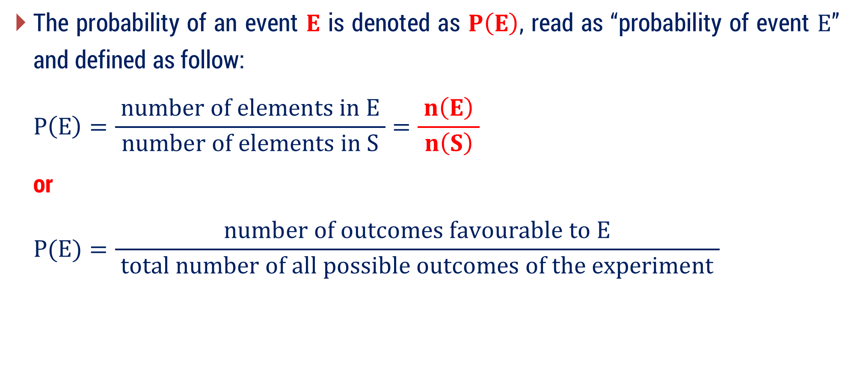
Probability of an Event
The probability of an event $E$ is denoted as $P\left(E\right)$, read as “probability of event $E$” and defined as follow:
$$P\left(E\right)=\frac{ number of elements in E }{ number of elements in S }=\frac{ n\left(E\right) }{ n\left(S\right) }$$
or
$$P(E)=\frac{ number of outcomes favourable to E }{ total number of all possible outcomes of the experiment }$$

Slide 59

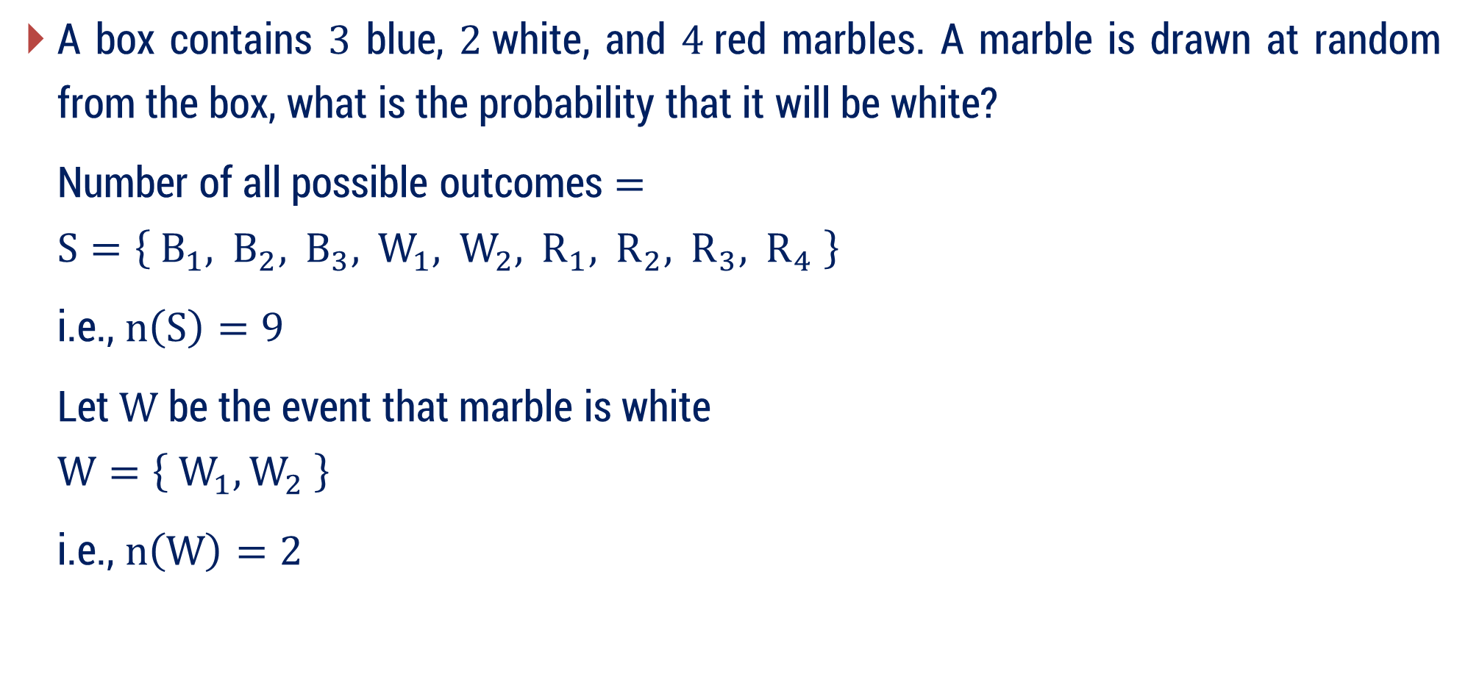



Example
A box contains $3$ blue, $2$white, and $4$red marbles. A marble is drawn at random from the box, what is the probability that it will be white?
Number of all possible outcomes $=$
$$S=\left\{ B_{1}, B_{2}, B_{3}, W_{1}, W_{2}, R_{1}, R_{2}, R_{3}, R_{4} \right\}$$
i.e., $n\left(S\right)=9$
Let $W$ be the event that marble is white
$$W=\left\{ W_{1}, W_{2} \right\}$$
i.e., $n\left(W\right)=2$
$$3+2+4=9$$
$$=\frac{ n\left(W\right) }{n\left(S\right) }$$
$$∴ P\left(W\right)$$
$$=\frac{2}{ 9 }$$

Slide 60
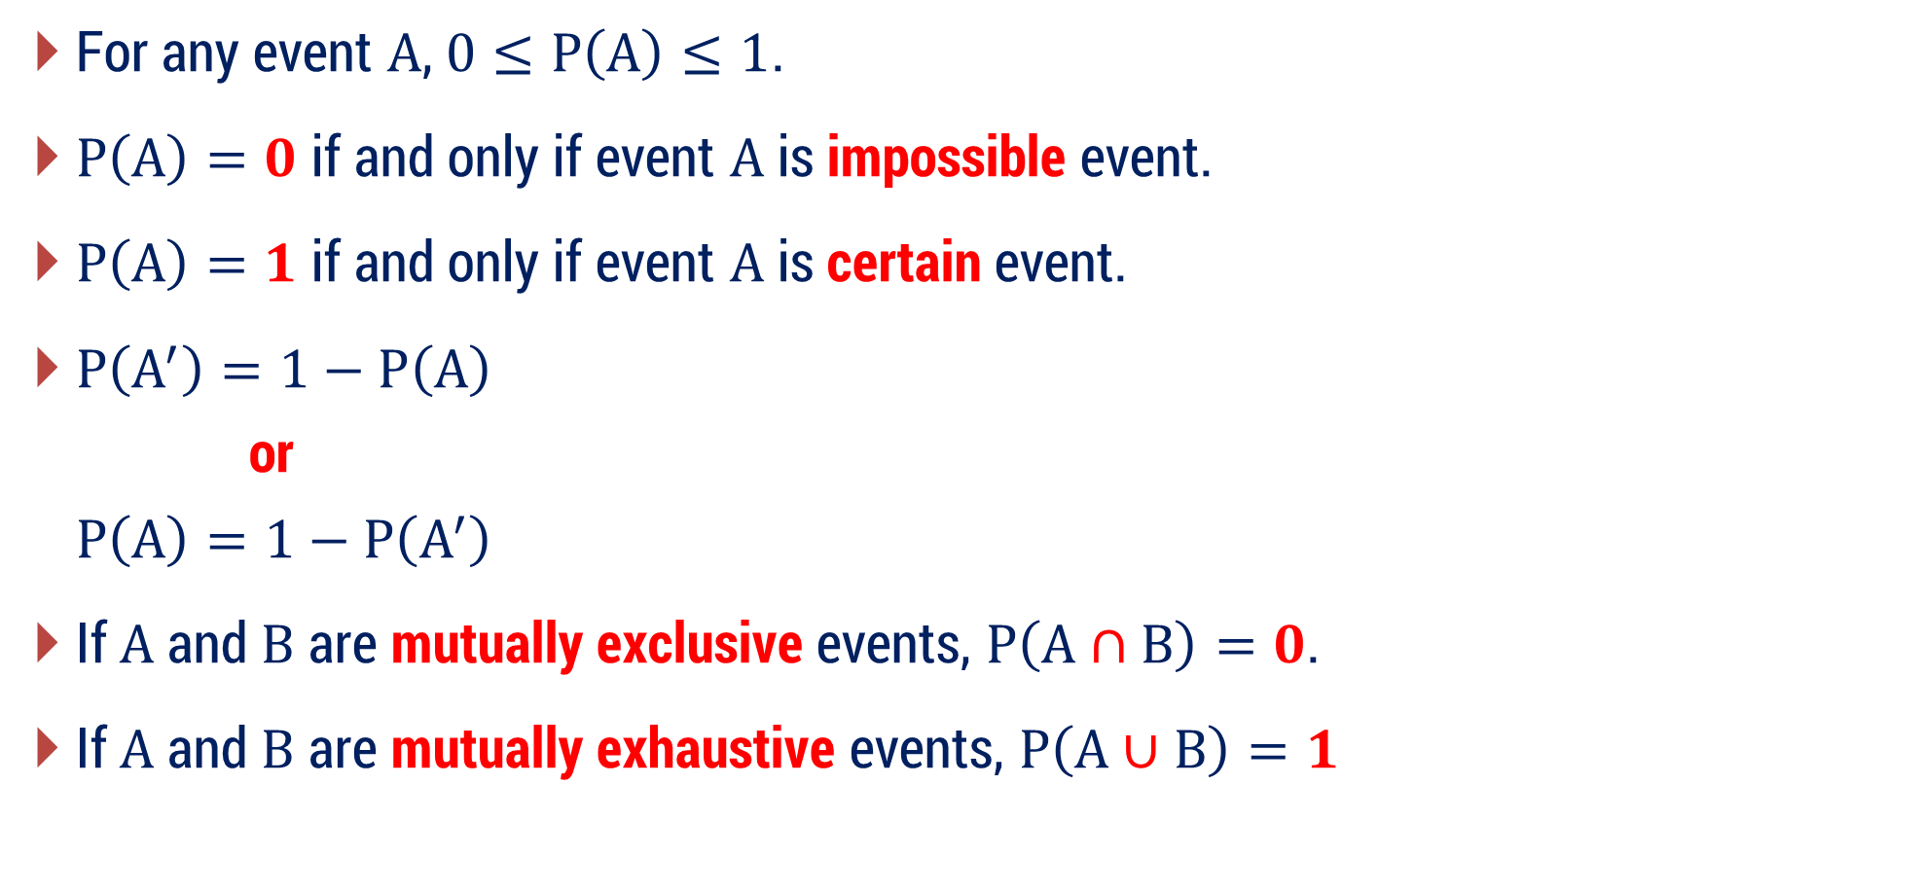
Some Important Results
For any event $A$, $0≤P\left(A\right)≤1$.
$P\left(A\right)=0$ if and only if event $A$ is impossible event.
$P\left(A\right)=1$ if and only if event $A$ is certain event.
$P\left(A^{′}\right)=1−P\left(A\right)$
$$\text{or}$$
$$P\left(A\right)=1−P\left(A^{′}\right)$$
If $A$ and $B$ are mutually exclusive events, $P\left(A∩B\right)=0$.
If $A$ and $B$ are mutually exhaustive events, $P\left(A∪B\right)=1$

Slide 61
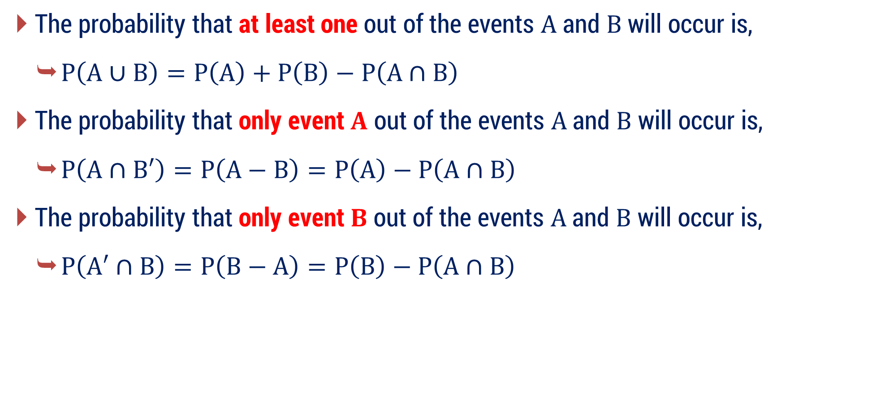
Some Important Results
The probability that at least one out of the events $A$ and $B$ will occur is,
$P\left(A∪B\right)=P\left(A\right)+P\left(B\right)−P\left(A∩B\right)$
The probability that only event $A$ out of the events $A$ and $B$ will occur is,
$P\left(A∩B′\right)=P\left(A−B\right)=P\left(A\right)−P\left(A∩B\right)$
The probability that only event $B$ out of the events $A$ and $B$ will occur is,
$P\left(A′∩B\right)=P\left(B−A\right)=P\left(B\right)−P\left(A∩B\right)$

Slide 62
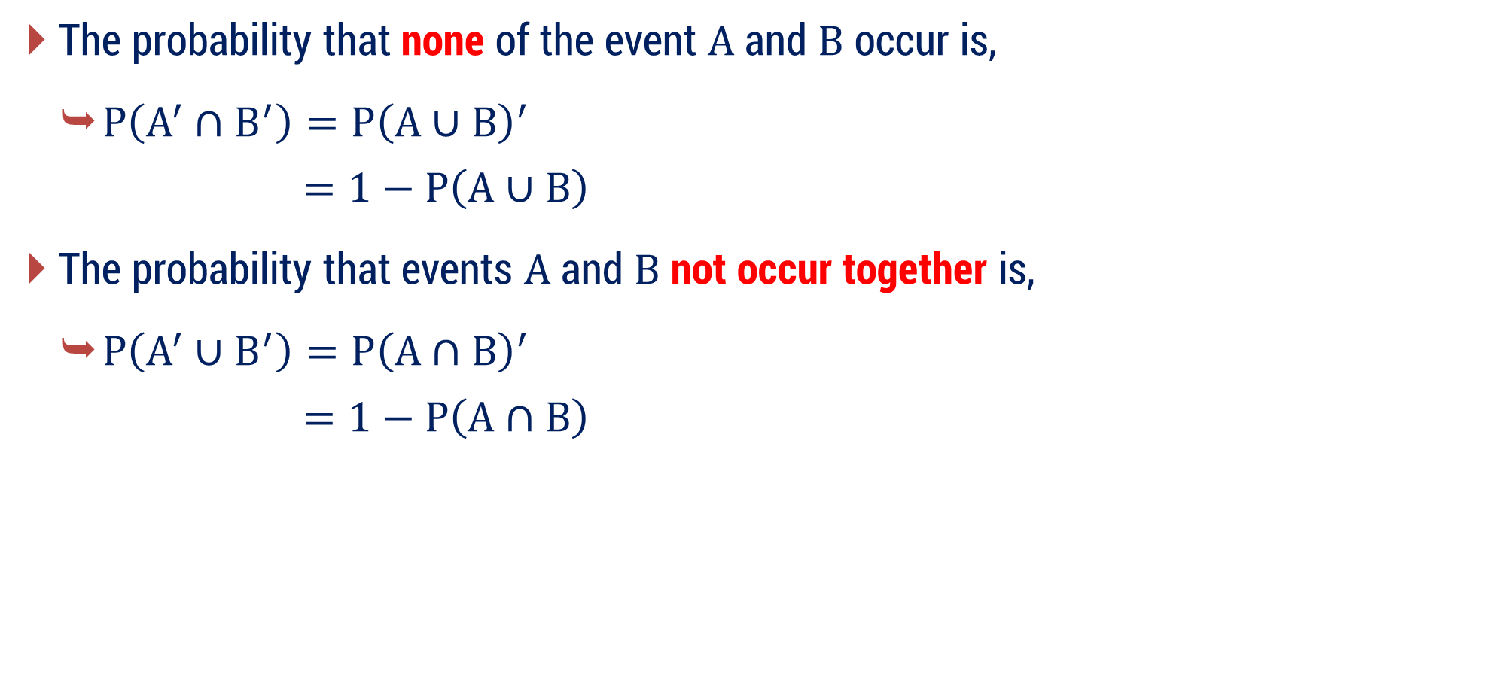
Some Important Results
The probability that none of the event $A$ and $B$ occur is,
$P\left(A^{′}∩B^{′}\right)=P{\left(A∪B\right)}^{′}$
$$=1−P\left(A∪B\right)$$
The probability that events $A$ and $B$ not occur together is,
$P\left(A^{′}∪B^{′}\right)=P{\left(A∩B\right)}^{′}$
$$=1−P\left(A∩B\right)$$
(De Morgan’s Rule)
(De Morgan’s Rule)

Slide 63
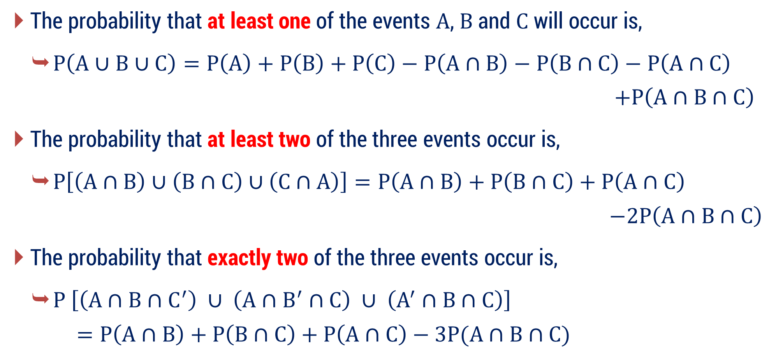
Some Important Results
The probability that at least one of the events $A$, $B$ and $C$ will occur is,
$P\left(A∪B∪C\right)=P\left(A\right)+P\left(B\right)+P\left(C\right)−P\left(A∩B\right)−P\left(B∩C\right)−P\left(A∩C\right)$
$$+P\left(A∩B∩C\right)$$
The probability that at least two of the three events occur is,
$P\left[\left(A∩B\right)∪\left(B∩C\right)∪\left(C∩A\right)\right]=P\left(A∩B\right)+P\left(B∩C\right)+P\left(A∩C\right)$
$$−2P\left(A∩B∩C\right)$$
The probability that exactly two of the three events occur is,
$P \left[\left(A∩B∩C^{′}\right) ∪ \left(A∩B^{′}∩C\right) ∪ \left(A^{′}∩B∩C\right)\right]$
$$=P\left(A∩B\right)+P\left(B∩C\right)+P\left(A∩C\right)−3P(A∩B∩C)$$

Slide 64
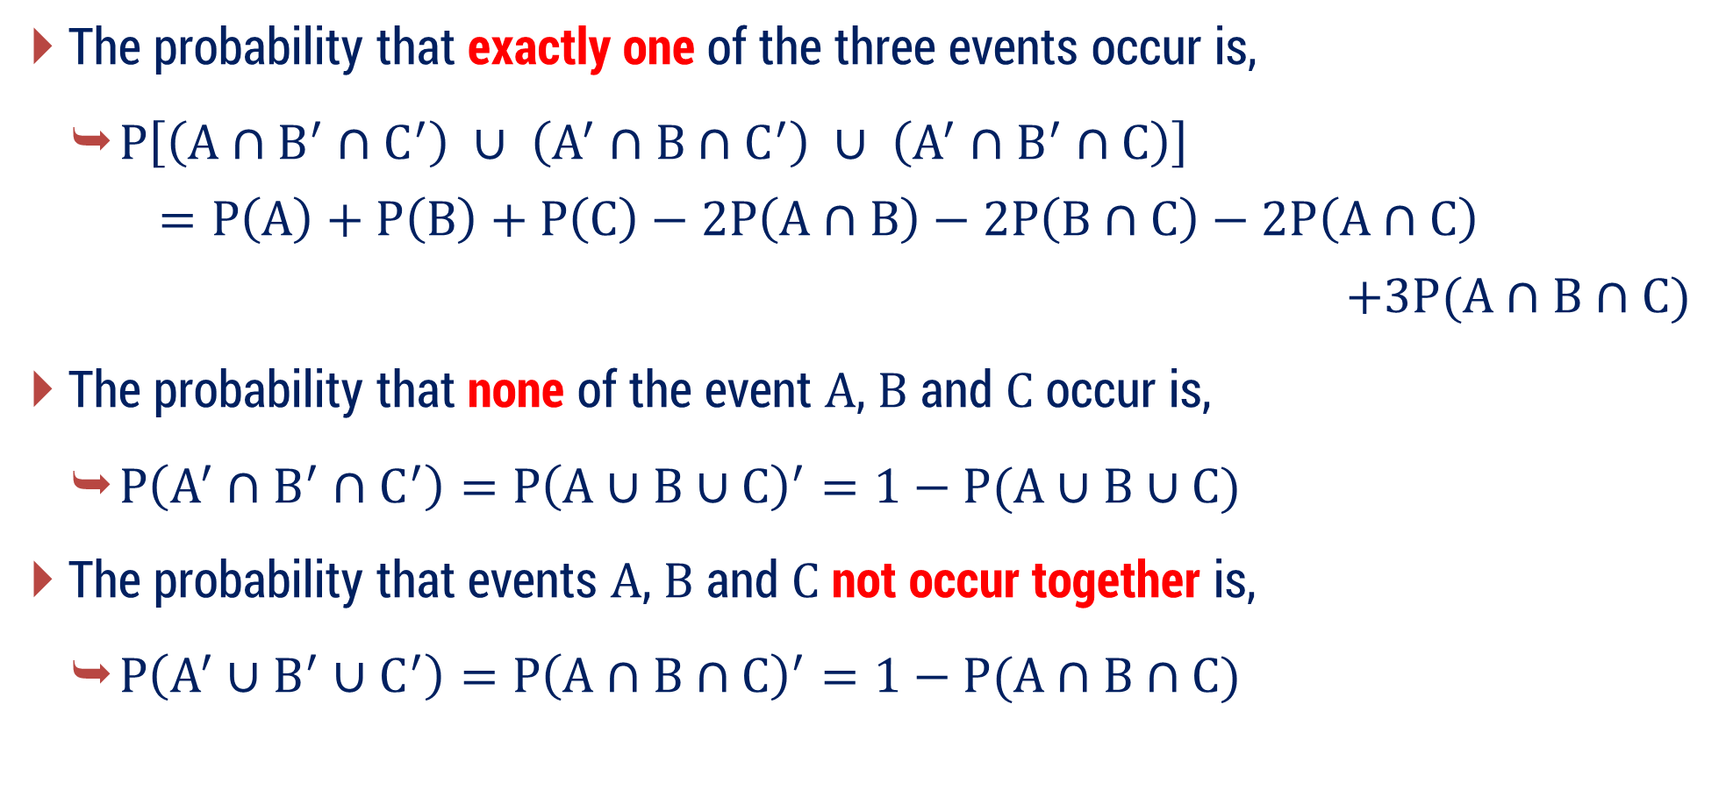
Some Important Results
The probability that exactly one of the three events occur is,
$P\left[\left(A∩B^{′}∩C^{′}\right) ∪ \left(A^{′}∩B∩C^{′}\right) ∪ \left(A^{′}∩B^{′}∩C\right)\right]$
$$=P\left(A\right)+P\left(B\right)+P\left(C\right)−2P\left(A∩B\right)−2P\left(B∩C\right)−2P\left(A∩C\right)$$
$$+3P(A∩B∩C)$$
The probability that none of the event $A$, $B$ and $C$ occur is,
$P\left(A^{′}∩B^{′}∩C^{′}\right)=P{\left(A∪B∪C\right)}^{′}=1−P(A∪B∪C)$
The probability that events $A$, $B$ and $C$ not occur together is,
$P\left(A^{′}∪B^{′}∪C^{′}\right)=P{\left(A∩B∩C\right)}^{′}=1−P(A∩B∩C)$
(De Morgan’s Rule)
(De Morgan’s Rule)

Slide 65
Examples of Method 2.2
Probability of an Event

Slide 66








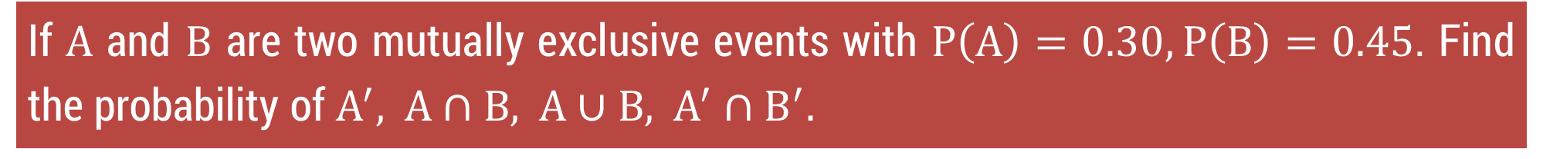












Method 2.2 ⇝ Example 1
If $A$ and $B$ are two mutually exclusive events with $P\left(A\right)=0.30,P\left(B\right)=0.45$. Find the probability of $A^{′}, A∩B, A∪B, A^{′}∩B^{′}.$
Solution:
Given that,
$$P\left(A\right)=0.30$$
$$P\left(B\right)=0.45$$
Also, $A$ and $B$ are two mutually exclusive events.
$$⇒$$
$$A∩B$$
$$=ϕ$$
Now,
$P\left(A^{′}\right)$
$$=1−P\left(A\right)$$
$P\left(A∪B\right)$
$$=P\left(A\right)+P\left(B\right)−P\left(A∩B\right)$$
$$=1−0.30$$
$$=0.30+0.45−0$$
$$=0.70$$
$$=0.75$$
$P\left(A^{′}∩B^{′}\right)$
$$=1−P\left(A∪B\right)$$
$P\left(A∩B\right)$
$$=0$$
$$=1−0.75$$
$$=0.25$$

Slide 67

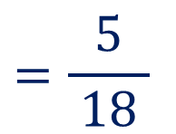
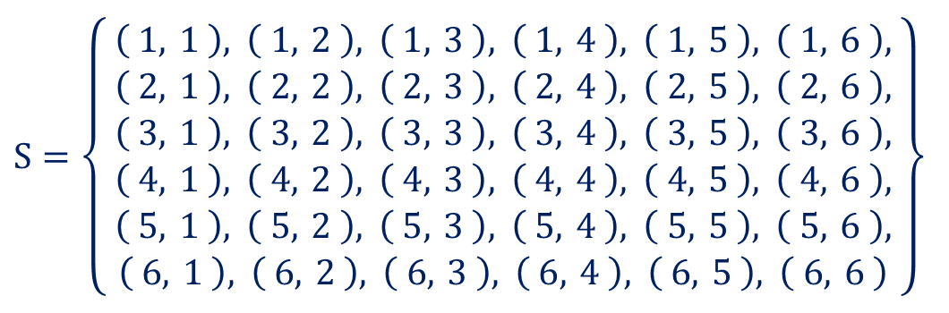

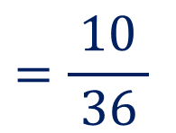





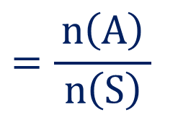
Method 2.2 ⇝ Example 2
Two unbiased dice are thrown. Find the probability that:
(1) The total of the numbers on the dice is greater than 8.
(2) The total of the numbers on the dice is 13.
(3) Total of numbers on the dice is any number from 2 to 12, both inclusive.
Solution:
Here,
$$n\left(S\right)=36$$
Event $A$ :
Total of the numbers on the dice is greater than $8$
$$⇒$$
$$n\left(A\right)=10$$
$$=\frac{n\left(A\right)}{ n\left(S\right) }$$
$$S=\left\{\begin{aligned}& \\ & \begin{matrix}\left( 1, 1 \right), \left( 1, 2 \right), \left( 1, 3 \right), \left( 1, 4 \right), \left( 1, 5 \right), \left( 1, 6 \right), \\ \left( 2, 1 \right), \left( 2, 2 \right), \left( 2, 3 \right), \left( 2, 4 \right), \left( 2, 5 \right), \left( 2, 6 \right), \\ \left( 3, 1 \right), \left( 3, 2 \right), \left( 3, 3 \right), \left( 3, 4 \right), \left( 3, 5 \right), \left( 3, 6 \right), \\ \left( 4, 1 \right), \left( 4, 2 \right), \left( 4, 3 \right), \left( 4, 4 \right), \left( 4, 5 \right), \left( 4, 6 \right), \\ \left( 5, 1 \right), \left( 5, 2 \right), \left( 5, 3 \right), \left( 5, 4 \right), \left( 5, 5 \right), \left( 5, 6 \right), \\ \left( 6, 1 \right), \left( 6, 2 \right), \left( 6, 3 \right), \left( 6, 4 \right), \left( 6, 5 \right), \left( 6, 6 \right)\end{matrix} \\ & \end{aligned}\right\}$$
$$⇒$$
$$P\left(A\right)$$
$$=\frac{10}{ 36 }$$
$$=\frac{5}{ 18 }$$

Slide 68






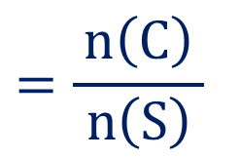


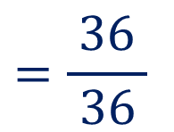






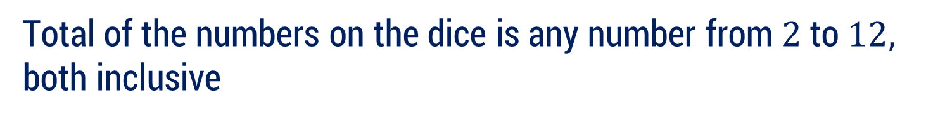
Method 2.2 ⇝ Example 2 (Continue)
(2) The total of the numbers on the dice is 13.
$$n\left(S\right)=36$$
Event $B$ :
Total of the numbers on the dice is $13$
$$⇒$$
$$n\left(B\right)=0$$
$$⇒$$
$$P\left(B\right)$$
$$=0$$
(3) Total of numbers on the dice is any number from 2 to 12, both inclusive.
Event $C$ :
Total of the numbers on the dice is any number from $2$ to $12$, both inclusive
$$⇒$$
$$n\left(C\right)=36$$
$$=\frac{n\left(C\right)}{ n\left(S\right) }$$
$$S=\left\{\begin{aligned}& \\ & \begin{matrix}\left( 1, 1 \right), \left( 1, 2 \right), \left( 1, 3 \right), \left( 1, 4 \right), \left( 1, 5 \right), \left( 1, 6 \right), \\ \left( 2, 1 \right), \left( 2, 2 \right), \left( 2, 3 \right), \left( 2, 4 \right), \left( 2, 5 \right), \left( 2, 6 \right), \\ \left( 3, 1 \right), \left( 3, 2 \right), \left( 3, 3 \right), \left( 3, 4 \right), \left( 3, 5 \right), \left( 3, 6 \right), \\ \left( 4, 1 \right), \left( 4, 2 \right), \left( 4, 3 \right), \left( 4, 4 \right), \left( 4, 5 \right), \left( 4, 6 \right), \\ \left( 5, 1 \right), \left( 5, 2 \right), \left( 5, 3 \right), \left( 5, 4 \right), \left( 5, 5 \right), \left( 5, 6 \right), \\ \left( 6, 1 \right), \left( 6, 2 \right), \left( 6, 3 \right), \left( 6, 4 \right), \left( 6, 5 \right), \left( 6, 6 \right)\end{matrix} \\ & \end{aligned}\right\}$$
$$⇒$$
$$P\left(C\right)$$
$$=\frac{36}{ 36 }$$
$$=1$$

Slide 69








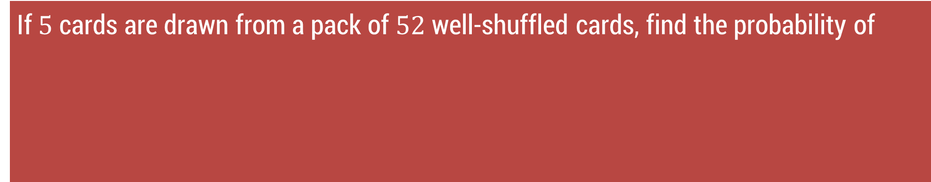





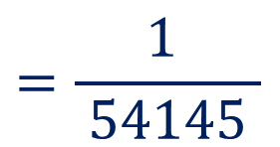




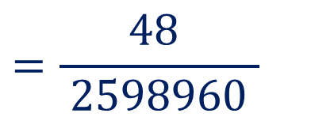




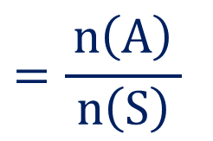
Method 2.2 ⇝ Example 3
If $5$ cards are drawn from a pack of $52$ well-shuffled cards, find the probability of
(1) 4 ace
(2) 4 aces and 1 is a king
(3) 3 are tens and 2 are jacks
(4) a nine, ten, jack, queen, king is obtained in any order
(5) 3 are of any one suit and 2 are of another
(6) at least one ace is obtained
Solution:
The total number of ways to choose $5$ cards from a $52$ card deck is:
$$n\left(S\right)$$
$$={}_{ }^{52}{C_{5}}$$
$$=2598960$$
Event $A$ :
$4$ aces are drawn
i.e.,
$4$ aces
and
$1$ any other card
$$⇒$$
$$n\left(A\right)$$
$$=$$
$${}_{ }^{4}{C_{4}}$$
$$×$$
$${}_{ }^{48}{C_{1}}$$
$$=\frac{n\left(A\right)}{ n\left(S\right) }$$
$$=\frac{48 }{ 2598960 }$$
$$=\frac{1 }{ 54145 }$$
$$⇒$$
$$P\left(A\right)$$
$$=$$
$$1$$
$$×$$
$$48$$
$$=$$
$$48$$

Slide 70


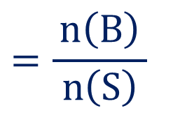




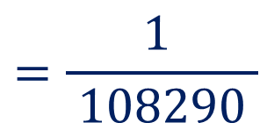














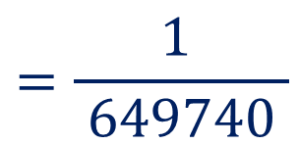








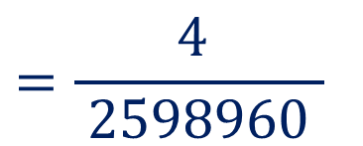









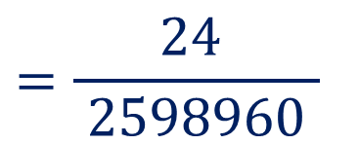
Method 2.2 ⇝ Example 3 (Continue)
(2) 4 aces and 1 is a king
$$n\left(S\right)$$
$$=2598960$$
Event $B$ :
$4$ aces and $1$ king is drawn
i.e.,
$4$ aces
and
$1$ king
$$⇒$$
$$n\left(B\right)$$
$$=$$
$${}_{ }^{4}{C_{4}}$$
$$×$$
$${}_{ }^{4}{C_{1}}$$
$$=\frac{n\left(B\right)}{ n\left(S\right) }$$
$$=\frac{4 }{ 2598960 }$$
$$=\frac{1 }{ 649740 }$$
$$=$$
$$1$$
$$×$$
$$4$$
$$⇒$$
$$P\left(B\right)$$
$$=$$
$$4$$
(3) 3 are tens and 2 are jacks
Event $C$ :
$3$ tens and $2$ jacks are drawn
$$⇒$$
$$n\left(C\right)$$
$$=$$
$${}_{ }^{4}{C_{3}}$$
$$×$$
$${}_{ }^{4}{C_{2}}$$
$$=\frac{n\left(C\right)}{ n\left(S\right) }$$
$$=\frac{24 }{ 2598960 }$$
$$=\frac{1 }{ 108290 }$$
$$=$$
$$4$$
$$×$$
$$6$$
$$⇒$$
$$P\left(C\right)$$
$$=$$
$$24$$
(4) a nine, ten, jack, queen, king is obtained in any order
(5) 3 are of any one suit and 2 are of another
(6) at least one ace is obtained

Slide 71


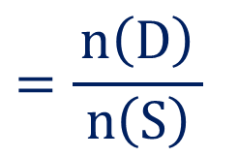







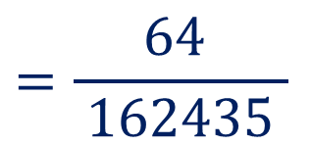










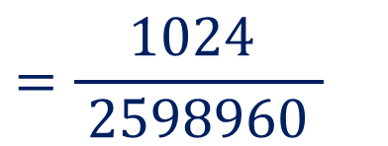







Method 2.2 ⇝ Example 3 (Continue)
(4) a nine, ten, jack, queen, king is obtained in any order
$$n\left(S\right)$$
$$=2598960$$
Event $D$ :
a nine, ten, jack, queen and a king is drawn in any order
$$⇒$$
$$n\left(D\right)$$
$$=$$
$${}_{ }^{4}{C_{1}}$$
$$×$$
$${}_{ }^{4}{C_{1}}$$
$$×$$
$${}_{ }^{4}{C_{1}}$$
$$×$$
$${}_{ }^{4}{C_{1}}$$
$$×$$
$${}_{ }^{4}{C_{1}}$$
$$=$$
$$4$$
$$×$$
$$4$$
$$×$$
$$4$$
$$×$$
$$4$$
$$×$$
$$4$$
$$=$$
$$1024$$
$$=\frac{n\left(D\right)}{ n\left(S\right) }$$
$$=\frac{1024 }{ 2598960 }$$
$$=\frac{64 }{ 162435 }$$
$$⇒$$
$$P\left(D\right)$$
(5) 3 are of any one suit and 2 are of another
(6) at least one ace is obtained

Slide 72


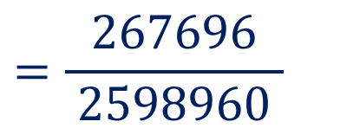




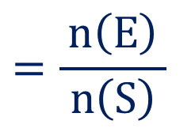



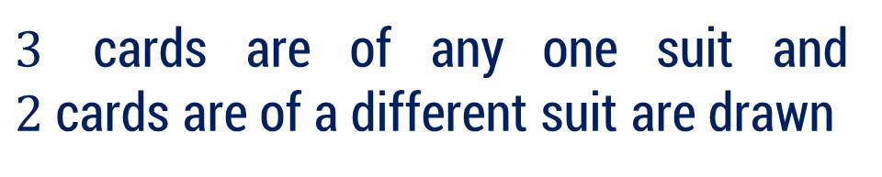






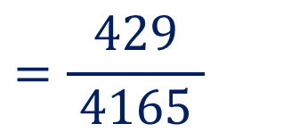



Method 2.2 ⇝ Example 3 (Continue)
(5) 3 are of any one suit and 2 are of another
$$n\left(S\right)$$
$$=2598960$$
Event $E$ :
$3$ cards are of any one suit and $2$ cards are of a different suit are drawn
Choices of suits :
$$4$$
$$⇒$$
$$n\left(E\right)$$
$$=$$
$${}_{ }^{13}{C_{3}}$$
$$×$$
$$4$$
$$×$$
$${}_{ }^{13}{C_{2}}$$
$$×$$
$$3$$
$$▪◻$$
$$=$$
$$267696$$
Remaining suits :
$$3$$
$$=\frac{n\left(E\right)}{ n\left(S\right) }$$
$$=\frac{267696}{ 2598960 }$$
$$=\frac{429}{ 4165 }$$
$$⇒$$
$$P\left(E\right)$$
(6) at least one ace is obtained

Slide 73







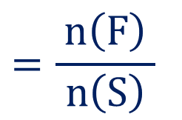




















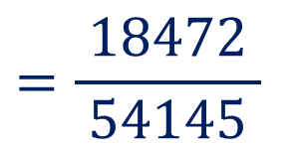






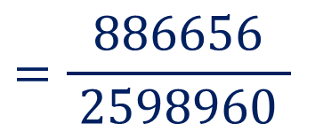





Method 2.2 ⇝ Example 3 (Continue)
(6) at least one ace is obtained
$$n\left(S\right)$$
$$=2598960$$
Event $F$ :
at least one ace is drawn
i.e.,
$5$ cards contains
$1$ ace
or
$2$ aces
or
$3$ aces
or
$4$ aces
$$n\left(F\right)=$$
$${}_{ }^{4}{C_{1}}$$
$$×$$
$${}_{ }^{48}{C_{4}}$$
$$+$$
$${}_{ }^{4}{C_{2}}$$
$$×$$
$${}_{ }^{48}{C_{3}}$$
$$+$$
$${}_{ }^{4}{C_{3}}$$
$$×$$
$${}_{ }^{48}{C_{2}}$$
$$+$$
$${}_{ }^{4}{C_{4}}$$
$$×$$
$${}_{ }^{48}{C_{1}}$$
$$=$$
$$+$$
$$103776$$
$$+$$
$$4512$$
$$+$$
$$778320$$
$$48$$
$$=$$
$$886656$$
$$=\frac{n\left(F\right)}{ n\left(S\right) }$$
$$=\frac{886656}{ 2598960 }$$
$$=\frac{\text{18472}}{ \text{54145} }$$
$$⇒$$
$$P\left(F\right)$$

Slide 74













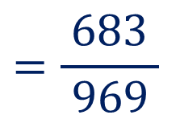


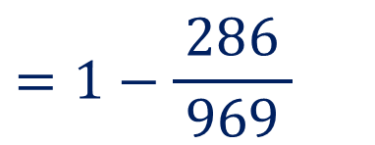




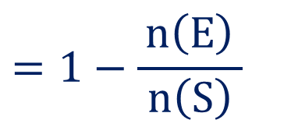
Method 2.2 ⇝ Example 4
An urn contains $6$ green, $4$ red and $9$ black balls. If $3$ balls are drawn at random, find the probability that at least one is green.
Solution:
Total balls
$$=$$
$6$ green
$$+$$
$4$ red
$$+$$
$9$ black
$$=19$$
The total number of ways to draw $3$ balls out of $19$ is:
$$n\left(S\right)$$
$$={}_{ }^{19}{C_{3}}$$
$$=969$$
Let,
$$⇒$$
$$P\left(E^{′}\right)$$
$$=1−P\left(E\right)$$
Event $E$ :
no green ball is drawn
$$=1−\frac{n\left(E\right)}{ n\left(S\right) }$$
So,
Event $E^{′}$ :
at least one green ball is drawn
$$=1−\frac{286}{ 969 }$$
$$=\frac{683}{ 969 }$$
Now,
$$n\left(E\right)$$
$$={}_{ }^{13}{C_{3}}$$
$$=286$$

Slide 75




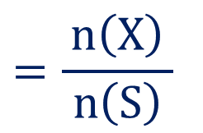








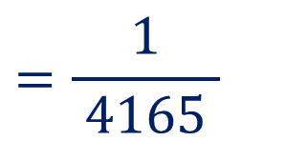





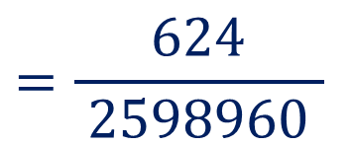
Method 2.2 ⇝ Example 5
Consider a poker hand of five cards. Find the probability of getting four of a kind (i.e., four cards of the same face value) assuming the five cards are chosen at random.
Solution:
The total number of ways to choose $5$ cards from a $52$ card deck is:
$$n\left(S\right)$$
$$={}_{ }^{52}{C_{5}}$$
$$=2598960$$
Event $X$ :
four out of the five cards have the same face value
Different face values :
$$13$$
$$⇒$$
$$n\left(X\right)$$
$$=$$
$$13$$
$$×$$
$${}_{ }^{4}{C_{4}}$$
$$×$$
$${}_{ }^{48}{C_{1}}$$
$$\text{(2, 3, 4, ..., 10, }\text{Jack}\text{, }\text{Queen}\text{, }\text{King}\text{, }\text{Ace}\text{)}$$
$$=$$
$$624$$
$$=\frac{n\left(X\right)}{ n\left(S\right) }$$
$$=\frac{624}{ 2598960 }$$
$$=\frac{\text{1}}{ \text{4165} }$$
$$⇒$$
$$P\left(X\right)$$

Slide 76































Method 2.2 ⇝ Example 6
An integer is chosen at random from the first $200$ positive integers. What is the probability that the integer is divisible by $6$ or $8$?
Solution:
Total integers from $1$ to $200$:
$$P\left(A∪B\right)$$
$$=$$
$$?$$
$$P\left(A\right)+P\left(B\right)−P\left(A∩B\right)$$
$$n\left(S\right)$$
$$=200$$
$A$ :
number is divisible by $6$
$B$ :
number is divisible by $8$
$$\left\lfloor \begin{aligned} \\ \frac{ 200 }{6}\end{aligned}\right\rfloor$$
$$=\frac{n\left(A\right)}{ n\left(S\right) }$$
$$=\frac{33}{ 200 }$$
$$⇒$$
$$n\left(A\right)$$
$$=$$
$$=\left\lfloor 33.33 \right\rfloor$$
$$=33$$
$$⇒$$
$$P\left(A\right)$$
$$\left\lfloor \begin{aligned} \\ \frac{ 200 }{8}\end{aligned}\right\rfloor$$
$$=\frac{n\left(B\right)}{ n\left(S\right) }$$
$$=\frac{25}{ 200 }$$
$$⇒$$
$$n\left(B\right)$$
$$=$$
$$=\left\lfloor 25 \right\rfloor$$
$$=25$$
$$⇒$$
$$P\left(B\right)$$

Slide 77


























Method 2.2 ⇝ Example 6 (Continue)
$A∩B$ :
number is divisible by both $6$and $8$
$$n\left(S\right)$$
$$=200$$
i.e.
number is divisible by $24$ [ $lcm\left(6, 8\right)$ ]
$$\left\lfloor \begin{aligned} \\ \frac{ 200 }{24}\end{aligned}\right\rfloor$$
$$=\frac{n\left(A∩B\right)}{ n\left(S\right) }$$
$$=\frac{8}{ 200 }$$
$$⇒$$
$$n\left(A∩B\right)$$
$$=$$
$$=\left\lfloor 8.33 \right\rfloor$$
$$=8$$
$$⇒$$
$$P\left(A∩B\right)$$
$$P\left(A∪B\right)$$
$$=$$
$$P\left(A\right)+P\left(B\right)−P\left(A∩B\right)$$
$$=\frac{33}{ 200 }$$
$$+ \frac{25}{ 200 }$$
$$− \frac{8}{ 200 }$$
$$=\frac{33}{ 200 }$$
$$P\left(A\right)$$
$$=\frac{1}{ 4 }$$
$$=\frac{25}{ 200 }$$
$$P\left(B\right)$$

Slide 78
































Method 2.2 ⇝ Example 7
A basket contains $20$ apples and $10$ oranges of which $5$ apples and $3$ oranges are bad. If a person takes $2$ at random, what is the probability that either both are apples or both are good?
Solution:
Bad
Good
$A$ :
Both fruits are apples
Apples
$$5$$
$$15$$
$$20$$
$B$ :
Both fruits are good
$$P\left(A∪B\right)$$
$$=$$
$$?$$
Oranges
$$3$$
$$7$$
$$10$$
$$P\left(A\right)+P\left(B\right)−P\left(A∩B\right)$$
$$8$$
$$22$$
$$30$$
$$=\frac{190}{ 435 }$$
$$n\left(A\right)$$
$$={}_{ }^{20}{C_{2}}$$
$$=190$$
$$⇒$$
$$P\left(A\right)$$
Ways to choose $2$ fruits from $30$:
$$=\frac{190}{ 435 }$$
$$n\left(S\right)$$
$$={}_{ }^{30}{C_{2}}$$
$$=435$$
$$n\left(B\right)$$
$$={}_{ }^{22}{C_{2}}$$
$$=231$$
$$⇒$$
$$P\left(B\right)$$

Slide 79

























Method 2.2 ⇝ Example 7 (Continue)
$A∩B$ :
both fruits are good apples
Bad
Good
Apples
$$5$$
$$15$$
$$20$$
$$n\left(A∩B\right)$$
$$={}_{ }^{15}{C_{2}}$$
$$=105$$
Oranges
$$3$$
$$7$$
$$10$$
$$=\frac{\text{105}}{ 435 }$$
$$8$$
$$22$$
$$30$$
$$⇒$$
$$P\left(A∩B\right)$$
$$n\left(S\right)$$
$$=435$$
$$P\left(A∪B\right)$$
$$=$$
$$P\left(A\right)+P\left(B\right)−P\left(A∩B\right)$$
$$=\frac{190}{ 435 }$$
$$+ \frac{190}{ 435 }$$
$$− \frac{\text{105}}{ 435 }$$
$$=\frac{190}{ 435 }$$
$$P\left(A\right)$$
$$=\frac{316}{ 435 }$$
$$=\frac{190}{ 435 }$$
$$P\left(B\right)$$

Slide 80













Method 2.2 ⇝ Example 8
Do as directed:
(1) Find the probability that there will be $5$ Sundays in the month of July.
Solution:
Month July has $31$ days.
Which Consist of $4$ weeks and $3$ extra days.
These $3$ extra days can be
$$4$$
{ Sun, Mon, Tue }
{ Wed, Thu, Fri }
{ Sat, Sun, Mon }
$$7$$
$$31$$
{ Mon, Tue, Wed }
{ Thu, Fri, Sat }
$$−$$
$$28$$
{ Tue, Wed, Thu }
{ Fri, Sat, Sun }
$$3$$
So, there are total $7$ possibilities out of which
$3$ have a Sunday.
$$=\frac{ 3 }{ 7 }$$
So, the probability of $5$ Sundays in July

Slide 81








Method 2.2 ⇝ Example 8 (Continue)
Do as directed:
(2) Find the probability that there will be $5$ Sundays in the month of June.
Solution:
Month June has $30$ days.
Which Consist of $4$ weeks and $2$ extra days.
These $2$ extra days can be
$$4$$
{ Sun, Mon }
{ Wed, Thu }
{ Sat, Sun }
$$7$$
$$30$$
{ Mon, Tue }
{ Thu, Fri }
$$−$$
$$28$$
{ Tue, Wed }
{ Fri, Sat }
$$2$$
So, there are total $7$ possibilities out of which
$2$ have a Sunday.
$$=\frac{ 2 }{ 7 }$$
So, the probability of $5$ Sundays in June

Slide 82















Method 2.2 ⇝ Example 8 (Continue)
Do as directed:
(3) What is the probability that a non-leap year contains $53$ Sundays?
Solution:
A non-leap year has $365$ days.
Which Consist of $52$ weeks and $1$ extra days.
These $1$ extra days can be
$$5$$
$$2$$
Sun
Wed
Sat
$$7$$
$$365$$
Mon
Thu
$$−$$
$$35$$
Tue
Fri
$$1$$
$$5$$
$$−$$
$$14$$
So, there are $7$ possibilities out of which
$1$ is a Sunday.
$$1$$
$$=\frac{ 1 }{ 7 }$$
So, the probability of $53$Sundays in a non-leap year

Slide 83









Method 2.2 ⇝ Example 8 (Continue)
Do as directed:
(4) What is the probability that a leap year contains $53$ Sundays?
Solution:
A leap year has $366$ days.
Which Consist of $52$ weeks and $2$ extra days.
These $2$ extra days can be
$$5$$
$$2$$
{ Sun, Mon }
{ Wed, Thu }
{ Sat, Sun }
$$7$$
$$366$$
{ Mon, Tue }
{ Thu, Fri }
$$−$$
$$35$$
{ Tue, Wed }
{ Fri, Sat }
$$1$$
$$6$$
$$−$$
$$14$$
So, there are $7$ possibilities out of which
$2$ have a Sunday.
$$2$$
$$=\frac{ 2 }{ 7 }$$
So, the probability of $53$Sundays in a leap year

Slide 84













Method 2.2 ⇝ Example 9
Four letters of the word “THURSDAY” are arranged in all possible ways. Find the probability that the word formed is “HURT”.
Solution:
The total number of arrangement of any $4$ letters from the $8$ letters in "THURSDAY"
$$⇒$$
$$n\left(S\right)$$
$$={}_{ }^{8}{P_{4}}$$
$$=1680$$
$A$ :
word “HURT” is formed
The word "HURT" can be formed in exactly 1 way from the letters in "THURSDAY."
$$⇒$$
$$n\left(A\right)$$
$$=1$$
$$=\frac{n\left(A\right)}{ n\left(S\right) }$$
$$=\frac{1}{ 1680 }$$
$$⇒$$
$$P\left(A\right)$$

Slide 85
Method 3 Conditional Probability and Independent Events

Slide 86

Conditional Probability
The probability of an event occurring given that another event has already occurred is known as conditional probability.
Let $A$ and $B$ be any two events in same sample space $S$.
The probability of the occurrence of event $A$ when it is given that $B$ has already occurred is known as conditional probability.
It is denoted as $P\left(A | B\right)$ and read as “conditional probability of $A$ given $B$” and defined as follow:
$$P\left(A | B\right)=\frac{ P\left(A∩B\right) }{P\left(B\right) }, P\left(B\right)≠0$$

Slide 87








Example
Consider the experiment of tossing three fair coins. To find probability of “getting at least two heads given that first coin shows tail” is conditional probability.
The sample space of the experiment is
$S = \left\{HHH, HHT, HTH, THH, HTT, THT, TTH, TTT \right\}$.
Event $E$ : at least two head appear
Event $F$ : first coin shows tail
Here, event $F$ has occurred before event $E$.
$$\text{Now}\text{, }\text{to} \text{find}$$
$$n\left(S\right)=8$$
$$E=\left\{ HHH, HHT, HTH, THH \right\}$$
$$n\left(E\right)=4$$
$$F=\left\{ THH, THT, TTH, TTT \right\}$$
$$n\left(F\right)=4$$
$$=\frac{ P\left(E∩F\right) }{P\left(F\right) }$$
$$P\left(E | F\right)$$

Slide 88















Example
$$E=\left\{ HHH, HHT, HTH, THH \right\}$$
$$F=\left\{ THH, THT, TTH, TTT \right\}$$
$$n\left(S\right)=8$$
$$n\left(E\right)=4$$
$$n\left(F\right)=4$$
$$E∩F=\left\{ THH \right\}$$
$$=\frac{ P\left(E∩F\right) }{P\left(F\right) }$$
$$P\left(E | F\right)$$
$$n\left(E∩F\right)=1$$
$$=\frac{1/{ 8 }}{ {1 }/2 }$$
$$P\left(E∩F\right)=\frac{ n\left(E∩F\right) }{n\left(S\right)}$$
$$=\frac{1}{ 8 }$$
$$=\frac{1}{ 4 }$$
$$P\left(F\right)=\frac{n\left(F\right)}{n\left(S\right)}$$
$$=\frac{4}{ 8 }=\frac{1}{ 2 }$$

Slide 89

Properties of Conditional Probability
Let $A_{1},A_{2}$ and $B$ be any three events of a sample space $S,$ then
$P\left(A_{1}∪A_{2} | B\right)=P\left(A_{1} | B\right)+P\left(A_{2} | B\right)−P\left(A_{1}∩A_{2} | B\right); P(B)>0.$
Let $A$ and $B$ be any two events of a sample space $S,$ then
$P\left(A^{′} | B\right)=1−P\left(A | B\right); P(B)>0.$

Slide 90

Multiplicative Law of Probability
Statement:
Let $A$ and $B$ be any two events in the sample space $S,$ then
$P\left(A∩B\right)=P\left(A\right)⋅P\left(B | A\right); P\left(A\right)≠0$
$=P\left(B\right)⋅P\left(A | B\right); P\left(B\right)≠0$
Let $A$, $B$ and $C$ be any three events in the sample space $S$, then
$P\left(A∩B∩C\right)=P\left(A\right)⋅P\left(B | A\right)⋅P\left(C | A∩B\right)$

Slide 91



Independent Events
Let $A$ and $B$ be two events associated with the same random experiment, then $A$ and $B$ are known as independent if and only if
$$P\left(A∩B\right)=P\left(A\right)⋅P\left(B\right)$$
Furthermore, if events $A$ and $B$ are independent events then
$P\left(A | B\right)=P\left(A\right)$
$P\left(B | A\right)=P\left(B\right)$
$$P\left(A | B\right)=\frac{P(A)⋅P(B)}{P\left(B\right)}$$
$$=P\left(A\right)$$

Slide 92

Mutually Independent Events
Three events $A$, $B$ and $C$ are known as mutually independent if
$P\left(A∩B\right)=P\left(A\right)⋅P\left(B\right)$
$P\left(B∩C\right)=P\left(B\right)⋅P\left(C\right)$
$P\left(A∩C\right)=P\left(A\right)⋅P\left(C\right)$
$P\left(A∩B∩C\right)=P\left(A\right)⋅P\left(B\right)⋅P\left(C\right)$
If the last condition is not satisfied, the events are said to be pairwise independent.

Slide 93
Examples of Method 3
Conditional Probability and Multiplicative Law of Probability

Slide 94














Method 3 ⇝ Example 1
$$P\left(A\right)=\frac{ 1 }{ 3 }, P\left(B^{′}\right)=\frac{ 1 }{ 4 } \text{and} P\left(A∩B\right)=\frac{ 1 }{ 6 }, \text{then} \text{find} P\left(A∪B\right), P\left(A^{′}∩B^{′}\right) \\ \text{and} P\left(A^{′} | B^{′}\right).$$
Solution:
$$P\left(B\right)=1−P\left(B^{′}\right)$$
$$P\left(A^{′}∩B^{′}\right)$$
$$=1−P\left(A∪B\right)$$
$$=1−\frac{1}{ 4 }$$
$$=\frac{3}{ 4 }$$
$$=1−\frac{11}{ 12 }$$
$$=\frac{1}{12}$$
$$P\left(A∪B\right)=P\left(A\right)+P\left(B\right)−P\left(A∩B\right)$$
$$=\frac{ P\left(A^{′}∩B^{′}\right) }{P\left(B^{′}\right) }$$
$$=\frac{ 1/{12} }{ 1/4 }$$
$$P\left(A^{′} | B^{′}\right)$$
$$P\left(A∪B\right)=\frac{1}{ 3 }+\frac{3}{ 4 }−\frac{1}{ 6 }$$
$$=\frac{11}{ 12 }$$
$$=\frac{ 1 }{ 3 }$$

Slide 95













Method 3 ⇝ Example 2
$$P\left(A\right)=\frac{ 1 }{ 3 }$$
$$P\left(B\right)=\frac{ 1 }{ 4 }$$
$$\text{If} , \text{and} P\left(A∪B\right)=\frac{ 1 }{ 2 }\text{,} \text{then} \text{find} P\left(B | A\right), .$$
$$P\left(A | B^{′}\right)$$
Solution:
$$P\left(A∪B\right)=P\left(A\right)+P\left(B\right)−P\left(A∩B\right)$$
Now,
$$=\frac{ P\left(A∩B\right) }{P\left(A\right) }$$
$$\frac{1}{ 2 }=\frac{1}{ 3 }+\frac{1}{ 4 }−P\left(A∩B\right)$$
$$P\left(B | A\right)$$
$$⇒$$
$$=\frac{1/{12} }{ 1/3 }$$
$$P\left(A∩B\right)=\frac{1}{ 3 }+\frac{1}{ 4 }−\frac{1}{ 2 }$$
$$⇒$$
$$=\frac{ 1 }{ 4 }$$
$$P\left(A∩B\right)=\frac{1}{ 12 }$$
$$⇒$$

Slide 96














Method 3 ⇝ Example 2 (Continue)
$$P\left(A\right)=\frac{ 1 }{ 3 }$$
$$P\left(B\right)=\frac{ 1 }{ 4 }$$
$$P\left(A∩B\right)=\frac{1}{ 12 }$$
$$P\left(B′\right)=1−P\left(B\right)$$
$$=\frac{ P\left(A∩B^{′}\right) }{P\left(B^{′}\right) }$$
$$=1−\frac{ 1 }{ 4 }$$
$$P\left(A | B^{′}\right)$$
$$=\frac{ 3 }{ 4 }$$
$$=\frac{1/4 }{ 3/4 }$$
$$P\left(A∩B′\right)$$
$$=P(A)−P\left(A∩ B\right)$$
$$=\frac{1 }{ 3 }$$
$$=\frac{ 1 }{ 3 }−\frac{1}{ 12 }$$
$$=\frac{ 1 }{ 4 }$$

Slide 97











Method 3 ⇝ Example 3
$$\text{If} A \text{and} B \text{are} \text{independent} \text{events}\text{, }\text{with} P\left(A\right)=\frac{3}{ 8 }, P\left(B\right)=\frac{7}{ 8 }.$$
$$\text{Find} P\left(A∪B\right), P\left(A | B\right) and P\left(B | A\right).$$
Solution:
$$P\left(A∪B\right)=P\left(A\right)+P\left(B\right)−P\left(A∩B\right)$$
$$P\left(A | B\right)$$
$$=P\left(A\right)$$
$$=P\left(A\right)+P\left(B\right)−$$
$$P\left(A\right)⋅P\left(B\right)$$
$$=\frac{3}{ 8 }$$
$$=\frac{3}{ 8 }+\frac{7}{ 8 }−\left(\frac{3}{ 8 }⋅\frac{7}{ 8 }\right)$$
$$P\left(B | A\right)$$
$$=P\left(B\right)$$
$$=\frac{59}{ 64 }$$
$$=\frac{7}{ 8 }$$

Slide 98








Method 3 ⇝ Example 4
A person is known to hit the target in $3$ out of $4$ shots, whereas another person is known to hit the target in $2$ out of $3$ shots. What is probability that target will be hit?
Solution:
$A$ : the first person hits the target
$B$ : the second person hits the target
$$P\left(A\right)=\frac{3}{ 4 }$$
$$P\left(B\right)=\frac{2}{ 3 }$$
To find the probability that the target will be hit,
we need the probability that at least one of the two persons hits the target.
$$P\left(A∪B\right)$$
$$=$$
$$P\left(A\right)+P\left(B\right)−P\left(A∩B\right)$$

Slide 99










Method 3 ⇝ Example 4 (Continue)
$$P\left(A\right)=\frac{3}{ 4 }$$
$$P\left(B\right)=\frac{2}{ 3 }$$
Since, the probability of one person hitting the target does not affect the other
$$A \text{and} B \text{are} \text{independent} \text{events}$$
$$P\left(A∪B\right)$$
$$=$$
$$P\left(A\right)+P\left(B\right)−P\left(A∩B\right)$$
$$=P\left(A\right)+P\left(B\right)−$$
$$P\left(A\right)⋅P\left(B\right)$$
$$=\frac{3}{ 4 }+\frac{2}{ 3 }−\left(\frac{3}{ 4 }⋅\frac{2}{ 3 }\right)$$
$$=\frac{11}{ 12 }$$

Slide 100
Method 3 ⇝ Example 5
A market survey was conducted in four cities to find out the preference for brand X soap. The responses are shown below:
 | Delhi | Kolkata | Chennai | Mumbai
Yes | 45 | 55 | 60 | 50
No | 35 | 45 | 35 | 45
No opinion | 5 | 5 | 5 | 5
210
160
20
85
105
100
100
390
What is the probability that a consumer preferred brand X, given that he was from Chennai?
Given that a consumer preferred brand X, what is the probability that he was from Mumbai?

Slide 101











Method 3 ⇝ Example 5 (Continue)
Solution:
 | Delhi | Kolkata | Chennai | Mumbai
Yes | 45 | 55 | 60 | 50
No | 35 | 45 | 35 | 45
No opinion | 5 | 5 | 5 | 5
$$n\left(S\right)$$
$$=390$$
210
160
20
85
105
100
100
390
What is the probability that a consumer preferred brand X, given that he was from Chennai?
$A$ : consumer is from Chennai
$B$ : consumer preferred Brand X
$${60}/{390}$$
$$=\frac{ P\left(A∩B\right) }{P\left(A\right) }$$
$$\frac{{60}/{390} }{ {100}/{390} }$$
$$P\left(B | A\right)$$
$$=$$
$$=0.6$$
$${100}/{390}$$
Given that a consumer preferred brand X, what is the probability that he was from Mumbai?

Slide 102







Method 3 ⇝ Example 5 (Continue)
Solution:
 | Delhi | Kolkata | Chennai | Mumbai
Yes | 45 | 55 | 60 | 50
No | 35 | 45 | 35 | 45
No opinion | 5 | 5 | 5 | 5
$$n\left(S\right)$$
$$=390$$
210
160
20
85
105
100
100
390
Given that a consumer preferred brand X, what is the probability that he was from Mumbai?
$B$ : consumer preferred Brand X
$C$ : consumer is from Mumbai
$${50}/{390}$$
$$=\frac{ P\left(B∩C\right) }{P\left(B\right) }$$
$$\frac{{60}/{390} }{ {100}/{390} }$$
$$P\left(C | B\right)$$
$$=$$
$$=0.2380$$
$${210}/{390}$$

Slide 103










Method 3 ⇝ Example 6
A problem in statistics is given to three students $A$, $B$ and $C$, whose chances of $$\text{solving} \text{it} \text{independently} \text{are} \frac{1}{ 2 }, \frac{1}{ 3 } \text{and} \frac{1}{ 4 } \text{respective}\text{y}\text{. }\text{Find} \text{the} \text{probability} \text{that}$$
(1) the problem is solved
(2) at least two of them are able to solve the problem
(3) exactly two of them are able to solve the problem
(4) exactly one of them is able to solve the problem
Solution:
$$=\frac{1}{ 2 }$$
Probability that student $A$ solves the problem:
$$P\left(A\right)$$
$$=\frac{1}{ 3 }$$
Probability that student $B$ solves the problem:
$$P\left(B\right)$$
$$=\frac{1}{ 4 }$$
Probability that student $C$ solves the problem:
$$P\left(C\right)$$

Slide 104



























Method 3 ⇝ Example 6 (Continue)
$$=\frac{1}{ 2 }$$
$$=\frac{1}{ 3 }$$
$$=\frac{1}{ 4 }$$
Note that here events $A$, $B$ and $C$ are mutually independent events.
$$P\left(A\right)$$
$$P\left(B\right)$$
$$P\left(C\right)$$
(1) the problem is solved
i.e., at least one of the students solves it
$$P\left(\text{a}\text{t} \text{least} \text{one} \text{solve}\right)$$
$$=$$
$$P\left(A\right)+P\left(B\right)+P\left(C\right)−P\left(A∩B\right)−P\left(B∩C\right)−P\left(A∩C\right)+P\left(A∩B∩C\right)$$
$$=$$
$$P\left(A\right)+P\left(B\right)+P\left(C\right)$$
$$− P\left(A\right)$$
$$⋅P\left(B\right)$$
$$− P\left(B\right)$$
$$⋅P\left(C\right)$$
$$− P\left(A\right)$$
$$⋅P\left(C\right)$$
$$+ P\left(A\right)$$
$$⋅P\left(B\right)$$
$$⋅P\left(C\right)$$
$$−\left(\frac{1}{ 2 }⋅\frac{1}{ 3 }\right)$$
$$−\left(\frac{1}{ 3 }⋅\frac{1}{ 4 }\right)$$
$$−\left(\frac{1}{ 2 }⋅\frac{1}{ 4 }\right)$$
$$+\left(\frac{1}{ 2 }⋅\frac{1}{ 3 }⋅\frac{1}{ 4 }\right)$$
$$\frac{1}{ 2 }+\frac{1}{ 3 }+\frac{1}{ 4 }$$
$$=$$
$$=\frac{3}{ 4 }$$
(2) at least two of them are able to solve the problem
(3) exactly two of them are able to solve the problem
(4) exactly one of them is able to solve the problem

Slide 105


















Method 3 ⇝ Example 6 (Continue)
$$=\frac{1}{ 2 }$$
$$=\frac{1}{ 3 }$$
$$=\frac{1}{ 4 }$$
$$P\left(A\right)$$
$$P\left(B\right)$$
$$P\left(C\right)$$
(2) at least two of them are able to solve the problem
$$P\left(\text{a}\text{t} \text{least} \text{two} \text{solve}\right)$$
$$=$$
$$P\left(A∩B\right)+P\left(B∩C\right)+P\left(A∩C\right)− 2P\left(A∩B∩C\right)$$
$$=$$
$$P\left(A\right)$$
$$⋅P\left(B\right)$$
$$+ P\left(B\right)$$
$$⋅P\left(C\right)$$
$$+ P\left(A\right)$$
$$⋅P\left(C\right)$$
$$− 2P\left(A\right)$$
$$⋅P\left(B\right)$$
$$⋅P\left(C\right)$$
$$\left(\frac{1}{ 2 }⋅\frac{1}{ 3 }\right)$$
$$+\left(\frac{1}{ 3 }⋅\frac{1}{ 4 }\right)$$
$$+\left(\frac{1}{ 2 }⋅\frac{1}{ 4 }\right)$$
$$−2\left(\frac{1}{ 2 }⋅\frac{1}{ 3 }⋅\frac{1}{ 4 }\right)$$
$$=$$
$$=\frac{7}{ 24 }$$
(3) exactly two of them are able to solve the problem
(4) exactly one of them is able to solve the problem

Slide 106








Method 3 ⇝ Example 6 (Continue)
$$=\frac{1}{ 2 }$$
$$=\frac{1}{ 3 }$$
$$=\frac{1}{ 4 }$$
$$P\left(A\right)$$
$$P\left(B\right)$$
$$P\left(C\right)$$
(3) exactly two of them are able to solve the problem
$$P\left(\text{exactly} \text{two} \text{solve}\right)$$
$$=$$
$$P\left(A∩B\right)+P\left(B∩C\right)+P\left(A∩C\right)− 3P\left(A∩B∩C\right)$$
$$=$$
$$P\left(A\right)$$
$$⋅P\left(B\right)$$
$$+ P\left(B\right)$$
$$⋅P\left(C\right)$$
$$+ P\left(A\right)$$
$$⋅P\left(C\right)$$
$$− 3P\left(A\right)$$
$$⋅P\left(B\right)$$
$$⋅P\left(C\right)$$
$$\left(\frac{1}{ 2 }⋅\frac{1}{ 3 }\right)$$
$$+\left(\frac{1}{ 3 }⋅\frac{1}{ 4 }\right)$$
$$+\left(\frac{1}{ 2 }⋅\frac{1}{ 4 }\right)$$
$$−3\left(\frac{1}{ 2 }⋅\frac{1}{ 3 }⋅\frac{1}{ 4 }\right)$$
$$=$$
$$=\frac{1}{ 4 }$$
(4) exactly one of them is able to solve the problem

Slide 107













Method 3 ⇝ Example 6 (Continue)
$$=\frac{1}{ 2 }$$
$$=\frac{1}{ 3 }$$
$$=\frac{1}{ 4 }$$
$$P\left(A\right)$$
$$P\left(B\right)$$
$$P\left(C\right)$$
(4) exactly one of them is able to solve the problem
$$P\left(\text{exactly} \text{one} \text{solve}\right)$$
$$=$$
$$P\left(A\right)+P\left(B\right)+P\left(C\right)−2P\left(A∩B\right)−2P\left(B∩C\right)−2P\left(A∩C\right)+3P\left(A∩B∩C\right)$$
$$=$$
$$P\left(A\right)+P\left(B\right)+P\left(C\right)$$
$$− 2P\left(A\right)$$
$$⋅P\left(B\right)$$
$$− 2P\left(B\right)$$
$$⋅P\left(C\right)$$
$$− 2P\left(A\right)$$
$$⋅P\left(C\right)$$
$$+ 3P\left(A\right)$$
$$⋅P\left(B\right)$$
$$⋅P\left(C\right)$$
$$− 2\left(\frac{1}{ 2 }⋅\frac{1}{ 3 }\right)$$
$$− 2\left(\frac{1}{ 3 }⋅\frac{1}{ 4 }\right)$$
$$− 2\left(\frac{1}{ 2 }⋅\frac{1}{ 4 }\right)$$
$$+ 3\left(\frac{1}{ 2 }⋅\frac{1}{ 3 }⋅\frac{1}{ 4 }\right)$$
$$\frac{1}{ 2 }+\frac{1}{ 3 }+\frac{1}{ 4 }$$
$$=$$
$$=\frac{11}{ 24 }$$

Slide 108











Method 3 ⇝ Example 7
In a group of $200$ students $40$ are taking English, $50$ are taking Mathematics, $12$ are taking both.
(1)
If a student is selected at random, what is the probability that the student is taking English?
Solution:
$$n\left(S\right)=200$$
$$=\frac{n\left(E\right)}{ n\left(S\right) }$$
$$P\left(E\right)$$
Event $E$ : Student taking English
$$n\left(E\right)=40$$
$$=\frac{40}{ 200 }$$
Event $M$ : Student taking Mathematics
$$n\left(M\right)=50$$
$$=\frac{1}{ 5 }$$
$$n\left(E∩M\right)=12$$

Slide 109


















Method 3 ⇝ Example 7 (Continue)
In a group of $200$ students $40$ are taking English, $50$ are taking Mathematics, $12$ are taking both.
(2)
A student is selected at random from those taking Mathematics. What is the probability that the student is taking English?
Solution:
$$n\left(S\right)=200$$
$$n\left(E\right)=40$$
$$n\left(M\right)=50$$
$$n\left(E∩M\right)=12$$
$$=\frac{ n\left(E∩M\right) }{n\left(S\right)}$$
$$=\frac{12}{ 200 }$$
$$=\frac{3}{ 50 }$$
$$=\frac{ P\left(E∩M\right) }{P\left(M\right)}$$
$$P\left( E | M\right)$$
$$P\left(E∩M\right)$$
$$E$$
$$M$$
$$=\frac{3/{50} }{ 1/4 }$$
$$=\frac{ n\left(M\right) }{n\left(S\right)}$$
$$=\frac{50}{ 200 }$$
$$=\frac{1}{ 4 }$$
$$=\frac{6}{ 25 }$$
$$P\left(M\right)$$

Slide 110








Method 3 ⇝ Example 7 (Continue)
In a group of $200$ students $40$ are taking English, $50$ are taking Mathematics, $12$ are taking both.
(3)
A student is selected at random from those taking English. What is the probability that the student is taking Mathematics?
Solution:
$$n\left(S\right)=200$$
$$n\left(E\right)=40$$
$$n\left(M\right)=50$$
$$n\left(E∩M\right)=12$$
$$=\frac{ P\left(E∩M\right) }{P\left(E\right)}$$
$$P\left(M | E \right)$$
$$M$$
$$E$$
$$P\left(E∩M\right)=\frac{3}{ 50 }$$
$$=\frac{3/{50} }{ 1/5 }$$
$$=\frac{3}{ 10 }$$
$$P\left(E\right)=\frac{1}{ 5 }$$

Slide 111











Method 3 ⇝ Example 8
A bag contains $6$ white, $9$ black balls. $4$ balls are drawn at a time. Find the probability for first draw to give $4$ white & second draw to give $4$ black balls in each of following cases:
(1) The balls are replaced before the second draw.
(2) The balls are not replaced before the second draw.
Solution:
Total number of balls:
$6$ white
$$+$$
$9$ black
$=15$ balls
$4$ balls are drawn at random
$A$ : The first draw gives $4$ white balls.
$B$ : The second draw gives $4$ black balls.
$$P\left(A∩B\right)$$
$$=$$
$$?$$

Slide 112






























Method 3 ⇝ Example 8 (Continue)
$A$ : The first draw gives $4$ white balls.
$6$ white
$$+$$
$9$ black
$=15$ balls
$B$ : The second draw gives $4$ black balls.
(1) The balls are replaced before the second draw.
Since the balls are replaced,
sample remains same.
$$⇒$$
Events $A$ and $B$ are independent events.
$${}_{ }^{6}{C_{4}}$$
$$P\left(A∩B\right)$$
$$=$$
$$P\left(A\right)⋅P\left(B\right)$$
$$\frac{15 }{ 1365 }$$
$$\frac{1}{ 91 }$$
$$?$$
$$P\left(A\right)$$
$$=$$
$$=$$
$$=$$
$${}_{ }^{15}{C_{4}}$$
$$\frac{1}{ 91 }⋅\frac{6}{ 65 }$$
$$=$$
$${}_{ }^{9}{C_{4}}$$
$$\frac{126 }{ 1365 }$$
$$\frac{6}{ 65 }$$
$$P\left(B\right)$$
$$=$$
$$=$$
$$=$$
$${}_{ }^{15}{C_{4}}$$
$$\frac{6}{ 5915 }$$
$$=$$
(2) The balls are not replaced before the second draw.

Slide 113




















Method 3 ⇝ Example 8 (Continue)
$A$ : The first draw gives $4$ white balls.
$6$ white
$$+$$
$9$ black
$=15$ balls
$B$ : The second draw gives $4$ black balls.
$$\frac{1}{ 91 }$$
$$P\left(A\right)$$
$$=$$
(2) The balls are not replaced before the second draw.
Since the balls are not replaced,
sample is affected by first draw.
Total balls in bag after first draw
$$=11$$
The probability of drawing $4$ black balls from these $11$ balls is:
$$P\left(B | A\right)$$
$$P\left(A∩B\right)$$
$$=$$
$$P\left(A\right)⋅P\left(B | A\right)$$
$${}_{ }^{9}{C_{4}}$$
$$\frac{126 }{ 330 }$$
$$\frac{21}{ 55 }$$
$$?$$
$$P\left(B | A\right)$$
$$=$$
$$=$$
$$=$$
$${}_{ }^{11}{C_{4}}$$
$$\frac{1}{ 91 }⋅\frac{21}{ 55 }$$
$$=$$
$$\frac{3}{ 715 }$$
$$=$$

Slide 114
Method 4 Bayes’ Theorem

Slide 115













Total Probability
Let $A_{1}, A_{2}, …, A_{n}$ be mutually exclusive and exhaustive events of the sample space $S$ with $P\left(A_{i}\right)≠0,$ for $i=1, 2, …, n.$ Let $B$ be any event associated with $S.$
$$A_{1}$$
$$A_{2}$$
$$A_{3}$$
$$⋯$$
$$A_{n}$$
$$B$$
$$B∩A_{1}$$
$$B∩A_{2}$$
$$B∩A_{3}$$
$$⋯$$
$$B∩A_{n}$$
$$S$$

Slide 116















Total Probability
$P\left(B\right)$
$$=P\left(B∩A_{1}\right)+ P\left(B∩A_{2}\right)+⋯+ P\left(B∩A_{i}\right)$$
$$P\left(B\right)$$
$$=P\left(A_{1}\right)⋅P\left(B | A_{1}\right) + P\left(A_{2}\right)⋅P\left(B | A_{2}\right) +…+ P\left(A_{n}\right)⋅P\left(B | A_{n}\right)$$
$$A_{1}$$
$$A_{2}$$
$$A_{3}$$
$$⋯$$
$$A_{n}$$
Using multiplicative law of
probability, we get
$$B$$
$$P\left(B∩A_{i}\right)=P\left(A_{i}\right) ⋅ P\left(B | A_{i}\right),$$
$$B∩A_{1}$$
$$B∩A_{2}$$
$$B∩A_{3}$$
$$⋯$$
$$B∩A_{n}$$
$$S$$

Slide 117














Example
Factory $A$ and Factory $B$, that produce electronic components. Factory $A$ produces $60\%$ of the components and among those, $10\%$ are defective. Factory $B$ produces the remaining $40\%$ of the components and among those, $5\%$ are defective. Find the probability that a randomly selected electronic component is defective.
Let $A_{1}$ : The component is from Factory $A$
$A_{2}$ : The component is from Factory $B$
$B$ : The component is defective
$$A_{1}$$
$$0.10$$
$$B$$
$$0.60$$
$$P\left(A_{1}\right)=0.60$$
$$P\left(B | A_{1}\right)=0.10$$
$$0.40$$
$$P\left(A_{2}\right)=0.40$$
$$P\left(B | A_{2}\right)=0. 05$$
$$A_{2}$$
$$0.05$$
$$B$$

Slide 118




















Example
$$P\left(A_{1}\right)=0.60$$
$$P\left(B | A_{1}\right)=0.10$$
$$A_{1}$$
$$0.10$$
$$B$$
$$0.60$$
$$P\left(A_{2}\right)=0.40$$
$$P\left(B | A_{2}\right)=0. 05$$
$$P\left(B\right)$$
$$=P\left(A_{1}\right)⋅P\left(B | A_{1}\right) + P\left(A_{2}\right)⋅P\left(B | A_{2}\right)$$
$$0.40$$
$$A_{2}$$
$$0.05$$
$$B$$
$$=\left(0.60\right)⋅$$
$$\left(0.10\right)$$
$$+ \left(0.40\right)⋅$$
$$\left(0.05\right)$$
$$=0.06$$
$$+ 0.02$$
$$=0.08$$

Slide 119



Bayes’ Theorem
Statement:
Let $A_{1}, A_{2}, A_{3}, …, A_{n}$ be mutually exclusive and exhaustive events of the sample space S with $P\left(A_{i}\right)≠0$, for $i=1, 2, 3, …, n.$ Let $B$ be any event associated with $S$ with $P\left(B\right)≠0$.
The probability of an event $A_{i}$ when the event $B$ has occurred is
$$\frac{ P\left(A_{i}\right)⋅P\left(B \left| A_{i}\right.\right)}{ P\left(A_{1}\right)⋅P\left(B \left| A_{1}\right.\right) + P\left(A_{2}\right)⋅P\left(B \left| A_{2}\right.\right) +⋯+ P\left(A_{n}\right)⋅P\left(B \left| A_{n}\right.\right)}$$
$$\left.P\left(A_{i} \right| B\right)=$$

Slide 120
Examples of Method 4
Bayes’ Theorem

Slide 121






Method 4 ⇝ Example 1
In a certain assembly plant, three machines $B_{1}, B_{2}$ & $B_{3}$ make $30\%, 45\%$ & $25\%$ respectively of the products. It is known form the past experience that $2\%, 3\%$ & $2\%$ of the products made by each machine respectively are defective. Now, suppose that a finished product is randomly selected. What is the probability that it is defective?
Solution:
Machines' Production :
Events:
$$B_{1}\left(30\%\right), B_{2}\left(45\%\right), B_{3}\left(25\%\right)$$
$A_{1}$ : Product made by Machine $X$
$A_{2}$ : Product made by Machine $Y$
Defective Rates :
$A_{3}$ : Product made by Machine $Z$
$$B_{1}\left(2\%\right), B_{2}\left(3\%\right), B_{3} \left(2\%\right)$$
$B$ : Selecting a defective product

Slide 122









Method 4 ⇝ Example 1 (Continue)
Machines' Production :
$$B_{1}\left(30\%\right), B_{2}\left(45\%\right), B_{3}\left(25\%\right)$$
Defective Rates :
$$B_{1}\left(2\%\right), B_{2}\left(3\%\right), B_{3} \left(2\%\right)$$
Probabilities:
$$P\left(A_{1}\right)=0.30$$
$$P\left(A_{2}\right)=0.45$$
$$P\left(A_{3}\right)=0.25$$
$$P\left(B | A_{1}\right)=0.02$$
$$P\left(B | A_{2}\right)=0.03$$
$$P\left(B | A_{3}\right)=0.02$$
Law of Total Probability:
$$P\left(B\right)$$
$$=P\left(A_{1}\right)⋅P\left(B | A_{1}\right) + P\left(A_{2}\right)⋅P\left(B | A_{2}\right)+ P\left(A_{3}\right)⋅P\left(B | A_{3}\right)$$
$$=\left(0.30\right)⋅\left(0.02\right) + \left(0.45\right)⋅\left(0.03\right)+ \left(0.25\right)⋅\left(0.02\right)$$
$$=0.0245$$

Slide 123












Method 4 ⇝ Example 2
An urn contains $10$ white and $3$ black balls, while another urn contains $3$ white and $5$ black balls. Two balls are drawn from the first urn and put into the second urn and then a ball is drawn from the later. What is the probability that it is a white ball?
Solution:
Urn $1$
Urn $2$
Events:
$10$White
$3$ White
$A_{1}$ : Two white balls drawn from Urn $1$
$3$ Black
$5$ Black
$A_{2}$ : Two black balls drawn from Urn $1$
$13$ Balls
$8$ Balls
$A_{3}$ : One white and one black balls drawn from Urn $1$
$B$ : White ball drawn from Urn $2$

Slide 124

















Method 4 ⇝ Example 2 (Continue)
Probabilities:
Urn $1$
Urn $2$
$10$White
$3$ White
$$=\frac{ {}_{ }^{10}{C_{2}} }{ {}_{ }^{13}{C_{2} }}$$
$$=\frac{15}{ 26 }$$
$$P\left(A_{1}\right)$$
$3$ Black
$5$ Black
$13$ Balls
$8$ Balls
$$=\frac{ {}_{ }^{3}{C_{2}} }{ {}_{ }^{13}{C_{2} }}$$
$$=\frac{1}{ 26 }$$
$$P\left(A_{2}\right)$$
$$=\frac{ {}_{ }^{10}{C_{1}}×{}_{ }^{3}{C_{1}} }{ {}_{ }^{13}{C_{2} }}$$
$$=\frac{5}{ 13 }$$
$$P\left(A_{3}\right)$$

Slide 125
































Method 4 ⇝ Example 2 (Continue)
After event $A_{1}$
After event $A_{2}$
After event $A_{3}$
Urn $2$
$2$ white
$2$ black
$1$ white $1$ black
$3$ White
Urn $2$
Urn $2$
Urn $2$
$5$ Black
$5$ White
$3$ White
$4$ White
$8$ Balls
$5$ Black
$7$ Black
$6$ Black
$$=\frac{15}{ 26 }$$
$$P\left(A_{1}\right)$$
$10$ Balls
$10$ Balls
$10$ Balls
$$=\frac{1}{ 26 }$$
$$P\left(A_{2}\right)$$
Probabilities:
$$=\frac{5}{ 10 }$$
$$=\frac{3}{ 10 }$$
$$=\frac{4}{ 10 }$$
$$=\frac{5}{ 13 }$$
$$P\left(B | A_{1}\right)$$
$$P\left(B | A_{2}\right)$$
$$P\left(B | A_{3}\right)$$
$$P\left(A_{3}\right)$$
$$=\frac{1}{ 2 }$$
$$=\frac{2}{ 5 }$$

Slide 126















Method 4 ⇝ Example 2 (Continue)
$$=\frac{15}{ 26 }$$
$$=\frac{1}{ 26 }$$
$$=\frac{5}{ 13 }$$
$$P\left(A_{1}\right)$$
$$P\left(A_{2}\right)$$
$$P\left(A_{3}\right)$$
$$=\frac{1}{ 2 }$$
$$=\frac{3}{ 10 }$$
$$=\frac{2}{ 5 }$$
$$P\left(B | A_{1}\right)$$
$$P\left(B | A_{2}\right)$$
$$P\left(B | A_{3}\right)$$
Law of Total Probability:
$$P\left(B\right)$$
$$=P\left(A_{1}\right)⋅P\left(B | A_{1}\right) + P\left(A_{2}\right)⋅P\left(B | A_{2}\right)+ P\left(A_{3}\right)⋅P\left(B | A_{3}\right)$$
$$=\left(\frac{15}{ 26 }\right)⋅\left(\frac{1}{ 2 }\right) + \left(\frac{1}{ 26 }\right)⋅\left(\frac{3}{ 10 }\right)+ \left(\frac{5}{ 13 }\right)⋅\left(\frac{2}{ 5 }\right)$$
$$=\frac{59 }{130 }$$

Slide 127










Method 4 ⇝ Example 3
Consider two boxes, first with $5$ green & $2$ pink and second with $4$ green & $3$ pink
balls. Two balls are selected from random box. If both balls are pink, find the
probability that they are from second box.
Solution:
Box $1$ : $5$ Green, $2$ Pink
($7$ balls)
Probabilities:
Box $2$ : $4$ Green, $3$ Pink
($7$ balls)
$$P\left(A_{1}\right)=\frac{1}{ 2 }$$
$$P\left(A_{2}\right)=\frac{1}{ 2 }$$
Events:
$$=\frac{ {}_{ }^{2}{C_{2}} }{ {}_{ }^{7}{C_{2} }}$$
$$=\frac{1}{ 21 }$$
$A_{1}$ : Selecting Box $1$
$$P\left(B | A_{1}\right)$$
$A_{2}$ : Selecting Box $2$
$$=\frac{ {}_{ }^{3}{C_{2}} }{ {}_{ }^{7}{C_{2} }}$$
$$=\frac{3}{ 21 }$$
$$P\left(B | A_{2}\right)$$
$B$ : Selecting two pink balls

Slide 128
Method 4 ⇝ Example 3 (Continue)
$$P\left(A_{1}\right)=\frac{1}{ 2 }$$
$$=\frac{1}{ 21 }$$
$$P\left(A_{2}\right)=\frac{1}{ 2 }$$
$$=\frac{3}{ 21 }$$
$$P\left(B | A_{1}\right)$$
$$P\left(B | A_{2}\right)$$
Bayes’ Theorem:
$$=\frac{ P\left(A_{2}\right)⋅P\left(B \left| A_{2}\right.\right)}{ P\left(A_{1}\right)⋅P\left(B \left| A_{1}\right.\right) + P\left(A_{2}\right)⋅P\left(B \left| A_{2}\right.\right) }$$
$$\left.P\left(A_{2} \right| B\right)$$
$$=\frac{\left(1/2\right)⋅\left(3/{21}\right)}{ \left(1/2\right)⋅\left(1/{21}\right) + \left(1/2\right)⋅\left(3/{21}\right) }$$
$$=\frac{3}{ 4 }$$

Slide 129
Method 4 ⇝ Example 4
A company has two plants to manufacture hydraulic machine. Plant $I$ manufacture $70\%$ of the hydraulic machines and Plant $II$ manufactures $30\%$. At Plant $I$, $80\%$ of hydraulic machines are rated standard quality and at Plant $II$, $90\%$ of hydraulic machine are rated standard quality. A machine is picked up at random and is found to be of standard quality. What is the chance that it has come from Plant $I$?
Solution:
Production Contribution:
Events:
$$\text{Plant} I \left(70\%\right), \text{Plant} II \left(30\%\right)$$
$A_{1}$ : The machine is from Plant $I$
$A_{2}$ : The machine is from Plant $II$
Standard Quality Proportions:
$B$ : The machine is of standard quality
$$\text{Plant} I \left(80\%\right), \text{Plant} II \left(90\%\right)$$

Slide 130
Method 4 ⇝ Example 4 (Continue)
Production Contribution:
$$\text{Plant} I \left(70\%\right), \text{Plant} II \left(30\%\right)$$
Standard Quality Proportions:
$$\text{Plant} I \left(80\%\right), \text{Plant} II \left(90\%\right)$$
Probabilities:
$$P\left(A_{1}\right)=0.70$$
$$P\left(A_{2}\right)=0.30$$
$$P\left(B | A_{1}\right)=0.80$$
$$P\left(B | A_{2}\right)=0.90$$
Bayes’ Theorem:
$$=\frac{ P\left(A_{1}\right)⋅P\left(B \left| A_{1}\right.\right)}{ P\left(A_{1}\right)⋅P\left(B \left| A_{1}\right.\right) + P\left(A_{2}\right)⋅P\left(B \left| A_{2}\right.\right) }$$
$$\left.P\left(A_{1} \right| B\right)$$
$$=\frac{\left(0.70\right)⋅\left(0.80\right)}{\left(0.70\right)⋅\left(0.80\right)+\left(0.30\right)⋅\left(0.90\right) }$$
$$=0.6747$$

Slide 131
Method 4 ⇝ Example 5
In a proposed medical screening on a population, the probability that the test correctly identifies someone with illness as positive is $0.99$ and the probability that test correctly identifies someone without illness as negative is $0.95$. The incident of illness in general population is $0.0001$. You take the test the result is positive then what is the probability that you have illness?
Solution:
Events:
$A_{1}$ : The individual has the illness
$$P\left(A_{1} | B\right)$$
$$= ?$$
$A_{2}$ : The individual does not have the illness
$$=A_{1}^{′}$$
$B$ : the result is positive
$$P\left(B | A_{1}\right)$$
Probabilities:
$$P\left(A_{1}\right)$$
$$=0.0001$$
$$B$$
$$A_{1}$$
$$=0.99$$
$$P\left(A_{2}\right)$$
$$=1−0.0001$$
$$=0.9999$$
$$P\left(B^{′} | A_{2}\right)$$
$$B^{′}$$
$$A_{2}$$
$$=0.95$$

Slide 132
Method 4 ⇝ Example 5 (Continue)
$$P\left(A_{1}\right)$$
$$=0.0001$$
$$P\left(B | A_{1}\right)$$
$$=0.99$$
$$P\left(A_{2}\right)$$
$$=0.9999$$
$$P\left(B^{′} | A_{2}\right)$$
$$=0.95$$
$$P\left(B | A_{2}\right)$$
$$=1−0.95$$
$$=0.05$$
Bayes’ Theorem:
$$=\frac{ P\left(A_{1}\right)⋅P\left(B \left| A_{1}\right.\right)}{ P\left(A_{1}\right)⋅P\left(B \left| A_{1}\right.\right) + P\left(A_{2}\right)⋅P\left(B \left| A_{2}\right.\right) }$$
$$P\left(A_{1} | B\right)$$
$$= ?$$
$$=\frac{\left(0.0001\right)⋅\left(0.99\right)}{ \left(0.0001\right)⋅\left(0.99\right)+\left(0.9999\right)⋅\left(0.05\right) }$$
$$=0.0020$$

Slide 133
Method 5 Random Variable and Probability Function

Slide 134
Random Variable
A variable whose values can be obtained from the results of a random experiment is known as random variable.
A random variable is a function associated with a sample space of a random experiment.
Random variable is often denoted by $X$, $Y$.
Random variable can be classified as bellow:
Discrete random variable
Continuous random variable

Slide 135
Discrete Random Variable
A random variable can take only finite values or countable infinite values is known as discrete random variable.
Discrete random variables can be measured exactly.
For example:
If two coins are tossed simultaneously the following sample space is generated:
$$S=\left\{ HH, HT, TH, TT \right\}$$
Now, if $X$ denotes the number of heads, then
$$X\left(HH\right)$$
$$=2,$$
$$X\left(HT\right)$$
$$=1,$$
$$X\left(TH\right)$$
$$=1,$$
$$X\left(TT\right)$$
$$=0,$$
i.e., random variable $X$ can take values
$$0, 1, 2.$$

Slide 136
Discrete Random Variable
Some other examples of discrete random variable.
Number of children in a family.
Numbers of stars in the sky.
Profit made by investor in a day

Slide 137
Continuous Random Variable
If a random variable can take all values within an interval, is known as continuous random variable.
Continuous random variable cannot be measured exactly.
For example:
The age of a person
Weight and height of a person
Life of an electric bulb

Slide 138
Discrete Random Variable
Some other examples of discrete random variable.
Number of children in a family.
Numbers of stars in the sky.
Profit made by investor in a day

Slide 139
Probability Distribution of Random Variable
Probability distribution of random variable is the set of its possible values together with their respective probabilities.
i.e.,
$$X$$
$$x_{1}$$
$$x_{2}$$
$$x_{3}$$
$$…$$
$$x_{n}$$
$$P\left(X=x\right)$$
$$p\left(x_{1}\right)$$
$$p\left(x_{2}\right)$$
$$p\left(x_{3}\right)$$
$$…$$
$$p\left(x_{n}\right)$$
$$\sum_{i=1}^{n}{p\left(x_{i}\right)}=1.$$
Where,
$$p\left(x_{i}\right)≥0$$
and

Slide 140
Example
Two balanced coins are tossed, then $S=\left\{ HH, HT, TH, TT \right\}$
We find the probability distribution of head.
Let $X$ be a random variable representing the number of heads obtained when two balanced coins are tossed.
$$=\frac{ 1 }{ 4 }$$
$$P\left(X=0\right)$$
$$=P\left( \text{no} \text{head} \right)$$
$$=0.25$$
$$=\frac{ 2 }{ 4 }$$
$$=\frac{ 1 }{ 2 }$$
$$P\left(X=1\right)$$
$$=P\left( \text{one} \text{head} \right)$$
$$=0.50$$
$$=\frac{ 1 }{ 4 }$$
$$P\left(X=2\right)$$
$$=P\left( \text{tw}\text{o} \text{head} \right)$$
$$=0.25$$

Slide 141
Example
Two balanced coins are tossed, then $S=\left\{ HH, HT, TH, TT \right\}$
We find the probability distribution of head.
So, probability distribution of $X$ is as follow:
$$P\left(X=0\right)$$
$$=0.25$$
$$X$$
$$0$$
$$1$$
$$2$$
$$P\left(X=1\right)$$
$$=0.50$$
$$P\left(X=x\right)$$
$$0.25$$
$$0.50$$
$$0.25$$
$$P\left(X=2\right)$$
$$=0.25$$

Slide 142
Probability Function
If for random variable $X$, the real valued function $f\left(x\right)$ is such that $P\left(X=x\right)=f\left(x\right)$, then $f\left(x\right)$ is called probability function of random variable $X$.
Probability function $f\left(x\right)$ gives the measures of probability for different values of $X$ say $x_{1}, x_{2}, …, x_{n}.$
Probability functions can be classified as
Probability Mass Function (P. M. F.) (for discrete random variable)
Probability Density Function (P. D. F.) (for continuous random variable)

Slide 143
Probability Mass Function
If $X$ is a discrete random variable that takes values $x_{1}, x_{2}, …, x_{n}$, then its probability function $f\left(x\right)$ or $P\left(X=x_{i}\right)=p\left(x_{i}\right)$ is called probability mass function, if it satisfies following conditions:
$p\left(x_{i}\right)≥0$, for all $i$
$$\sum_{i=1}^{n}{p(x_{i})}=1$$

Slide 144
Probability Mass Function
Note:
If $a<x_{1}<x_{2}<…<x_{k}<…<x_{n−1}<x_{n}<b, then$
$P\left(x<b\right)=$
$P\left(x>a\right)=$
$P\left(x_{1}≤x≤x_{k}\right)=$
$$P\left(X=a\right) + P\left(X=x_{1}\right) + ⋯ + P\left(X=x_{n−1}\right) + P\left(X=x_{n}\right)$$
$$P\left(X=x_{1}\right) + P\left(X=x_{2}\right) + ⋯ + P\left(X=b\right)$$
$$P\left(X=x_{1}\right) + P\left(X=x_{2}\right) + ⋯ + P\left(X=x_{k}\right)$$

Slide 145
Probability Density Function
If $X$ is a continuous random variable, then its probability function $f(x)$ is called continuous probability function, if it satisfies following conditions:
$f\left(x\right)≥0$, for all $x$
$$\int_{−∞}^{∞}{f\left(x\right)}dx=1$$

Slide 146
Probability Density Function
Note:
$$\int_{−∞}^{b}{f\left(x\right)}dx$$
$P\left(x≤b\right)=$
$$\int_{a}^{∞}{f\left(x\right)}dx$$
$P\left(x>a\right)=$
$$\int_{a}^{b}{f\left(x\right)}dx$$
$P\left(a≤x≤b\right)=$

Slide 147
Examples of Method 5
Random Variable and Probability Function

Slide 148
Method 5 ⇝ Example 1
$$\text{Is} P\left(X=x\right)={\left(\frac{ 1 }{ 2 }\right)}^{x}{\left(\frac{ 1 }{ 2 }\right)}^{1−x}; x=0, 1 \text{a} \text{probability} \text{function}\text{?}$$
Solution:
$P\left(X=x\right)$ is a probability function if it satisfies following conditions:
$$2. \sum_{x ∈ X}{P\left(X=x\right)}=1$$
$1. P\left(X=x\right)≥0,$ for all $x$
$$={\left(\frac{ 1 }{ 2 }\right)}^{0}{\left(\frac{ 1 }{ 2 }\right)}^{1−0}$$
$$=\frac{ 1 }{ 2 }$$
For $x=0$:
$$P\left(X=0\right)$$
$$={\left(\frac{ 1 }{ 2 }\right)}^{1}{\left(\frac{ 1 }{ 2 }\right)}^{1−1}$$
$$=\frac{ 1 }{ 2 }$$
For $x=1$:
$$P\left(X=1\right)$$

Slide 149
Method 5 ⇝ Example 2 (Continue)
$$=\frac{ 1 }{ 2 }$$
$$=\frac{ 1 }{ 2 }$$
$$P\left(X=0\right)$$
$$P\left(X=1\right)$$
Here, $P(X=x)≥0 for all x$
$$\sum_{x ∈ X}{P\left(X=x\right)}$$
Now,
$$= P\left(X=0\right)$$
$$+ P\left(X=1\right)$$
$$=\frac{ 1 }{ 2 }$$
$$+ \frac{ 1 }{ 2 }$$
$$= 1$$
$$\text{Thus}\text{,} P\left(X=x\right)={\left(\frac{ 1 }{ 2 }\right)}^{x}{\left(\frac{ 1 }{ 2 }\right)}^{1−x}; x=0, 1 \text{is} \text{a} \text{probability} \text{function}\text{.}$$

Slide 150
Method 5 ⇝ Example 2
A random variable $X$ has the following probability function.
Find the value of $k$ and then evaluate ,
$$P(x<6)$$
$$P\left(x≥6\right)$$
$$\text{and}$$
$$P\left(0<x<5\right)$$
$$X$$ | $$0$$ | $$1$$ | $$2$$ | $$3$$ | $$4$$ | $$5$$ | $$6$$ | $$7$$
$$P\left(X=x\right)$$ | $$0$$ | $$k$$ | $$2k$$ | $$2k$$ | $$3k$$ | $$k^{2}$$ | $$2k^{2}$$ | $$7k^{2}+k$$
Solution:
We know that,
$\sum{P\left(X=x\right)}=1$
$$⇒$$
$$P\left(X=0\right)+P\left(X=1\right)+P\left(X=2\right)+P\left(X=3\right)$$
$$+P\left(X=4\right)+P\left(X=5\right)+P\left(X=6\right)+P\left(X=7\right)$$
$$=1$$
$$⇒$$
$$0+k+2k+2k+3k+k^{2}+2k^{2}+7k^{2}+k$$
$$=1$$
$$⇒$$
$$9k+10k^{2}$$
$$=1$$

Slide 151
Method 5 ⇝ Example 2 (Continue)
$$X$$ | $$0$$ | $$1$$ | $$2$$ | $$3$$ | $$4$$ | $$5$$ | $$6$$ | $$7$$
$$P\left(X=x\right)$$ | $$0$$ | $$k$$ | $$2k$$ | $$2k$$ | $$3k$$ | $$k^{2}$$ | $$2k^{2}$$ | $$7k^{2}+k$$
$$9k+10k^{2}$$
$$=1$$
$$⇒$$
$$10k^{2}+9k−1=0$$
$$⇒$$
$$10k^{2}+10k−k−1=0$$
$$⇒$$
$$10k\left(k+1\right)−1\left(k+1\right)=0$$
$$⇒$$
$$\left(k+1\right)\left(10k−1\right)=0$$
$$P(x<6)$$
$$⇒$$
$$k=−1$$
(not valid since probabilities cannot be negative)
$$P\left(x≥6\right)$$
$$k=0.1$$
$$P\left(0<x<5\right)$$

Slide 152
Method 5 ⇝ Example 2 (Continue)
$$X$$ | $$0$$ | $$1$$ | $$2$$ | $$3$$ | $$4$$ | $$5$$ | $$6$$ | $$7$$
$$P\left(X=x\right)$$ | $$0$$ | $$k$$ | $$2k$$ | $$2k$$ | $$3k$$ | $$k^{2}$$ | $$2k^{2}$$ | $$7k^{2}+k$$
$$k=0.1$$
$$P(x<6)$$
$$=k+2k+2k+3k+k^{2}$$
$$P\left(x≥6\right)$$
$$=1−P\left(x<6\right)$$
$$=8k+k^{2}$$
$$=1−0.81$$
$$=8\left(0.1\right)+{\left(0.1\right)}^{2}$$
$$=0.19$$
$$=0.81$$
$$P\left(0<x<5\right)$$
$$=k+2k+2k+3k$$
$$=8k$$
$$=8\left(0.1\right)$$
$$=0.8$$

Slide 153
Method 5 ⇝ Example 3
$$\text{If} P\left(X=x\right)=\frac{ x }{15 }, x=1 \text{to} 5. \text{Find} P\left(1 or 2\right)\text{ \&}\text{ .}$$
$$P\left(0.5<X<2.5 | X>1\right)$$
$$P\left(X=x\right)=\frac{x}{ 15 }, x=1, 2, 3, 4, 5.$$
Solution:
The probability mass function is:
$$P\left(1 or 2\right)$$
$$=P\left(X=1\right)$$
$$+ P\left(X=2\right)$$
$$=\frac{1}{ 15 }+\frac{2}{ 15 }$$
$$=\frac{3}{ 15 }$$
$$=\frac{1}{ 15 }$$

Slide 154
Method 5 ⇝ Example 3 (Continue)
$$P\left(X=x\right)=\frac{x}{ 15 }, x=1, 2, 3, 4, 5.$$
$$P\left(\left(0.5<X<2.5\right)∩\left(X>1\right)\right)$$
$$P\left(0.5<X<2.5 | X>1\right)$$
$$=$$
$$P\left(X>1\right)$$
$$P\left(X>1\right)$$
$$=P\left(X=2\right)+P\left(X=3\right)+P\left(X=4\right)+P\left(X=5\right)$$
$$=\frac{2}{ 15 }+\frac{3}{ 15 }+\frac{4}{ 15 }+\frac{5}{ 15 }$$
$$=\frac{14}{ 15 }$$
Now,
The event $0.5<X<2.5$corresponds to
$$X=1, 2$$
$$=\frac{2}{ 15 }$$
So,
$$P\left(\left(0.5<X<2.5\right)∩\left(X>1\right)\right)$$
$$=P\left(X=2\right)$$

Slide 155
Method 5 ⇝ Example 3 (Continue)
$$=\frac{14}{ 15 }$$
$$=\frac{2}{ 15 }$$
$$P\left(X>1\right)$$
$$P\left(\left(0.5<X<2.5\right)∩\left(X>1\right)\right)$$
$$P\left(\left(0.5<X<2.5\right)∩\left(X>1\right)\right)$$
$$P\left(0.5<X<2.5 | X>1\right)$$
$$=$$
$$P\left(X>1\right)$$
$$\frac{2/{15}}{ {14}/{15} }$$
$$=$$
$$\frac{2}{ 14 }$$
$$=$$

Slide 156
Method 5 ⇝ Example 4
Verify that the following function is P.D.F or not?
$$f\left(x\right)=\left\{ \begin{aligned}\frac{2x}{ 9 }\left(2−\frac{x}{ 2 }\right) ; 0≤x≤3 \\ \\ 0 ;elsewhere\end{aligned}\right.$$
Solution:
$f\left(x\right)$ is a probability density function if it satisfies following conditions:
$$\frac{ 2x }{9}≥0 \text{for} 0≤x≤3$$
Here,
Now,
$$0≤x≤3$$
$1. f\left(x\right)≥0,$ for all $x$
$$0≥−\frac{x}{ 2 }≥1.5$$
$$2. \int_{−∞}^{∞}{f\left(x\right)}dx=1$$
$$2≥2−\frac{x}{ 2 }≥0.5$$

Slide 157
Method 5 ⇝ Example 4 (Continue)
$$\frac{ 2x }{9}≥0 \text{for} 0≤x≤3$$
$$f\left(x\right)=\left\{ \begin{aligned}\frac{2x}{ 9 }\left(2−\frac{x}{ 2 }\right) ; 0≤x≤3 \\ \\ 0 ;elsewhere\end{aligned}\right.$$
Here,
Now,
$$0≤x≤3$$
$$0≥−\frac{x}{ 2 }≥1.5$$
Also,
$f\left(x\right)=0$, elsewhere
$$2≥2−\frac{x}{ 2 }≥0.5$$
Hence,
$$2−\frac{x}{ 2 }≥0 \text{for}$$
$f\left(x\right)≥0$, for all $x$.
So,
$$\frac{2x}{ 9 }\left(2−\frac{x}{ 2 }\right)≥0 \text{for} 0≤x≤3$$
$$⇒$$

Slide 158
Method 5 ⇝ Example 4 (Continue)
$$\int_{−∞}^{∞}{f\left(x\right)}dx$$
$$=\int_{−∞}^{0}{f\left(x\right)} dx$$
$$+\int_{0}^{3}{f\left(x\right)} dx$$
$$+\int_{3}^{∞}{f\left(x\right)}dx$$
$$f\left(x\right)=\left\{ \begin{aligned}\frac{2x}{ 9 }\left(2−\frac{x}{ 2 }\right) ; 0≤x≤3 \\ \\ 0 ;elsewhere\end{aligned}\right.$$
$$+\int_{0}^{3}{\left(\frac{ 4x }{ 9 }−\frac{ x^{2} }{ 9 }\right)} dx$$
$$=0$$
$$+ 0$$
$$={\frac{1}{ 9 }\left[ \frac{ 4x^{2} }{ 2 }−\frac{ x^{3} }{ 3 } \right]}_{0}^{3}$$
$$={\frac{1}{ 9 }\left[2x^{2}−\frac{ x^{3} }{ 3} \right]}_{0}^{3}$$

Slide 159
Method 5 ⇝ Example 4 (Continue)
$$\int_{−∞}^{∞}{f\left(x\right)}dx$$
$$={\frac{1}{ 9 }\left[2x^{2}−\frac{ x^{3} }{ 3} \right]}_{0}^{3}$$
Thus,
$$f\left(x\right)=\left\{ \begin{aligned}\frac{2x}{ 9 }\left(2−\frac{x}{ 2 }\right) ; 0≤x≤3 \\ \\ 0 ;elsewhere\end{aligned}\right.$$
$$={\frac{1}{ 9 }\left[2x^{2}−\frac{ x^{3} }{ 3} \right]}_{0}^{3}$$
is P.D.F.
$$\left(2{\left(3\right)}^{2}−\frac{ {\left(3\right)}^{3} }{ 3}\right)$$
$$=\frac{1}{ 9 }\left[\left(2{\left(3\right)}^{2}−\frac{ {\left(3\right)}^{3} }{ 3}\right) \right]$$
$$−$$
$$\left(0\right)$$
$$=\frac{1}{ 9 }\left[18−9\right]$$
$$=\frac{1}{ 9 }\left[9\right]$$
$$=1$$

Slide 160
Method 5 ⇝ Example 5
Is the function $f(x)$ defined as below is a probability function? If so, find the probability that the variate having this density falls in the interval $(1, 2)$.
$$f(x)=\left\{ \begin{aligned}e^{−x} ; x≥0 \\ \\ 0 ;x<0\end{aligned}\right.$$
Solution:
$f\left(x\right)$ is a probability density function if it satisfies following conditions:
For $x≥0,$
$$f\left(x\right)=e^{−x}≥0$$
For $x<0,$
$$f\left(x\right)=0$$
$1. f\left(x\right)≥0,$ for all $x$
Hence,
$f\left(x\right)≥0$, for all $x$.
$$2. \int_{−∞}^{∞}{f\left(x\right)}dx=1$$

Slide 161
Method 5 ⇝ Example 5 (Continue)
$$\int_{−∞}^{∞}{f\left(x\right)}dx$$
$$=\int_{−∞}^{0}{f\left(x\right)} dx$$
$$+\int_{0}^{∞}{f\left(x\right)}dx$$
$$f(x)=\left\{ \begin{aligned}e^{−x} ; x≥0 \\ \\ 0 ;x<0\end{aligned}\right.$$
$$P(1<X<2)$$
$$=\int_{1}^{2}{f\left(x\right)}dx$$
$$+\int_{0}^{∞}{e^{−x}} dx$$
$$=0$$
$$=\int_{1}^{2}{e^{−x}}dx$$
$$={−\left[ e^{−x} \right]}_{0}^{∞}$$
$$=−\left[ 0−1 \right]$$
$$={−\left[ e^{−x} \right]}_{1}^{2}$$
$$=1$$
$$=−\left[ e^{−2}−e^{−1} \right]$$
Thus, $f\left(x\right)$ is P.D.F.
$$= e^{−1}−e^{−2}$$
$$=0.2325$$

Slide 162
Method 6 Various Measures of Statistics

Slide 163
Mathematical Expectation
If $X$ is a discrete random variable having various possible values $x_{1},x_{2},…,x_{n}$ and $P\left(X=x\right)$ is the probability mass function, the mathematical expectation of $X$ is defined & denoted by
$$E(X)=\sum_{i=1}^{n}{x_{i}⋅p\left(x_{i}\right)}$$
If $X$ is a continuous random variable which has probability density function $f\left(x\right)$, the mathematical expectation of $X$ is defined as
$$E\left(X\right)=\int_{−∞}^{∞}{x⋅f\left(x\right)}dx$$
$E\left(X\right)$ is also known as the mean value of the probability distribution of $X$.

Slide 164
Properties of Mathematical Expectation
Expected value of constant term is constant. i.e., $E\left(c\right)=c$.
If $a$, $b$ and $c$ are constants, then
$$E\left(\frac{ aX±b }{c}\right)=\frac{ 1 }{ c }[a⋅E(X)±b ]$$
For Probability mass function,
$$E\left(X^{2}\right)=\sum_{i=1}^{n}{x_{i}^{2}⋅p\left(x_{i}\right)}$$

Slide 165
Properties of Mathematical Expectation
For Probability density function,
$$E\left(X^{2}\right)=\int_{−∞}^{∞}{x^{2}⋅f\left(x\right)}dx$$
If $X$ and $Y$ are two random variables, then $E\left(X+Y\right)=E\left(X\right)+E\left(Y\right).$
If $X$ and $Y$ are two independent random variables, then $E\left(X∙Y\right)=E\left(X\right)∙E\left(Y\right).$

Slide 166
Variance of Random Variable
Variance is a characteristic of random variable $X$ and it is used to measure dispersion (or variation) of $X$.
If $X$ is a random variable with probability mass function$P(X)$, then expected value of ${\left[X−E\left(X\right)\right]}^{2}$is known as the variance of $X$ and it is denoted by $V\left(X\right).$
$V\left(X\right)=E\left(X^{2}\right)−{\left[E\left(X\right)\right]}^{2}$

Slide 167
Properties of Variance
$V\left(c\right)=0,$ where, $c$ is a constant.
If $a$ and $b$ are constants, then
$V\left(aX+b\right)=a^{2}⋅V(X)$.
If $X$ and $Y$ are the independent random variables, then $V\left(X+Y\right)=V\left(X\right)+V\left(Y\right).$

Slide 168
Standard Deviation of Random Variable
The positive square root of $V\left(X\right)$ (Variance of $X$) is called standard deviation of random variable $X$ and is denoted by$σ.$
i.e., $σ=\sqrt{ V\left(X\right) }$

Slide 169
Examples of Method 6
Various Measures of Statistics

Slide 170
Method 6 ⇝ Example 1
Probability distribution of a random variable X is given below.
Find , , , .
$E\left(X\right)$,
$$V\left(X\right)$$
$$σ\left(X\right)$$
$$E\left(3X+2\right)$$
$$V \left(3X+2\right)$$
$$X$$ | $$1$$ | $$2$$ | $$3$$ | $$4$$
$$P\left(X=x\right)$$ | $$0.1$$ | $$0.2$$ | $$0.5$$ | $$0.2$$
$$=\sum_{x ∈ X}{x⋅p\left(x\right)}$$
Solution:
$$E\left(X\right)$$
$$=(1⋅0.1)+(2⋅0.2)+(3⋅0.5)+\left(4⋅0.2\right)$$
$$=0.1+0.4+1.5+0.8$$
$$=2.8$$

Slide 171
Method 6 ⇝ Example 1 (Continue)
$$=\sum_{x ∈ X}{x^{2}⋅p\left(x\right)}$$
$$X$$ | $$1$$ | $$2$$ | $$3$$ | $$4$$
$$P\left(X=x\right)$$ | $$0.1$$ | $$0.2$$ | $$0.5$$ | $$0.2$$
$$E\left(X^{2}\right)$$
$$E\left(X\right)$$
$$=2.8$$
$$=(1^{2}⋅0.1)+(2^{2}⋅0.2)+(3^{2}⋅0.5)+\left(4^{2}⋅0.2\right)$$
$$=8.6$$
$$V\left(X\right)$$
$$=E\left(X^{2}\right)−{\left[E\left(X\right)\right]}^{2}$$
$$=8.6−{\left[2.8\right]}^{2}$$
$$=0.76$$
$$E\left(3X+2\right)$$
$$σ\left(X\right)$$
$$=\sqrt{ V\left(X\right) }$$
$$=0.8718$$
$$V \left(3X+2\right)$$

Slide 172
Method 6 ⇝ Example 1 (Continue)
$$X$$ | $$1$$ | $$2$$ | $$3$$ | $$4$$
$$P\left(X=x\right)$$ | $$0.1$$ | $$0.2$$ | $$0.5$$ | $$0.2$$
$$E\left(3X+2\right)$$
$$=3 E\left(X\right)+2$$
$$=3 \left(8.6\right)+2$$
$$E\left(X\right)$$
$$=2.8$$
$$=10.4$$
$$E\left(X^{2}\right)$$
$$=8.6$$
$$V\left(X\right)$$
$$=0.76$$
$$V \left(3X+2\right)$$
$$=3^{2}⋅V\left(X\right)$$
$$σ\left(X\right)$$
$$=0.8718$$
$$=9⋅0.76$$
$$=6.84$$

Slide 173
Method 6 ⇝ Example 2
Let mean and standard deviation of a random variable $X$ be $5$ & $5$ respectively, find $E\left(X^{2}\right)$ and $E{\left(2X+5\right)}^{2}$.
Solution:
Given that,
$$E\left(X\right)=5$$
&
$$σ\left(X\right)=5$$
$$⇒$$
$$\text{V}\text{(}\text{X}\text{)}$$
$$=25$$
We know that,
Now,
$$V\left(X\right)$$
$$=E\left(X^{2}\right)−{\left[E\left(X\right)\right]}^{2}$$
$$E{\left(2X+5\right)}^{2}$$
$$=E\left(4X^{2}+20X+25\right)$$
$$25$$
$$=E\left(X^{2}\right)−{\left[5\right]}^{2}$$
$$=4 E\left(X^{2}\right)+20 E\left(X\right)+25$$
$$E\left(X^{2}\right)$$
$$=25+25$$
$$=4 \left(50\right)+20 \left(5\right)+25$$
$$E\left(X^{2}\right)$$
$$=50$$
$$=325$$

Slide 174
Method 6 ⇝ Example 3
The following table gives the probabilities that a certain computer will malfunction $0, 1, 2, 3, 4, 5$ or $6$ times on any one day.
Number of malfunctions $x$ | 0 | 1 | 2 | 3 | 4 | 5 | 6
Probability $p\left(x\right)$ | 0.17 | 0.29 | 0.27 | 0.16 | 0.07 | 0.03 | 0.01
Find the mean and variance of this probability distribution.
$$=\sum_{x ∈ X}{x⋅p\left(x\right)}$$
Solution:
$$E\left(X\right)$$
$$=\left(0\right)\left(0.17\right)+\left(1\right)\left(0.29\right)+\left(2\right)\left(0.27\right)+\left(3\right)\left(0.16\right)+\left(4\right)\left(0.07\right)$$
$$+\left(5\right)\left(0.03\right)+\left(6\right)\left(0.01\right)$$
$$=0+0.29+0.54+0.48+0.28+0.15+0.06$$
$$=1.8$$

Slide 175
Method 6 ⇝ Example 3 (Continue)
Number of malfunctions $x$ | 0 | 1 | 2 | 3 | 4 | 5 | 6
Probability $p\left(x\right)$ | 0.17 | 0.29 | 0.27 | 0.16 | 0.07 | 0.03 | 0.01
$$E\left(X\right)$$
$$=1.8$$
$$=\sum_{x ∈ X}{x^{2}⋅p\left(x\right)}$$
$$E\left(X^{2}\right)$$
$$=\left(0\right)\left(0.17\right)+\left(1\right)\left(0.29\right)+\left(4\right)\left(0.27\right)+\left(9\right)\left(0.16\right)+\left(16\right)\left(0.07\right)$$
$$+\left(25\right)\left(0.03\right)+\left(36\right)\left(0.01\right)$$
$$=0+0.29+1.08+1.44+1.12+0.75+0.36$$
$$=5.04$$

Slide 176
Method 6 ⇝ Example 3 (Continue)
Number of malfunctions $x$ | 0 | 1 | 2 | 3 | 4 | 5 | 6
Probability $p\left(x\right)$ | 0.17 | 0.29 | 0.27 | 0.16 | 0.07 | 0.03 | 0.01
$$E\left(X\right)$$
$$=1.8$$
$$E\left(X^{2}\right)$$
$$=5.04$$
$$V\left(X\right)$$
$$=E\left(X^{2}\right)−{\left[E\left(X\right)\right]}^{2}$$
$$=5.04−{\left[1.8\right]}^{2}$$
$$=1.8$$

Slide 177
Method 6 ⇝ Example 4
$4$ raw mangoes are mixed accidentally with the $16$ ripe mangoes. Find the probability distribution of the raw mangoes in a draw of $2$ mangoes.
Solution:
Total Mangoes:
$4$ raw
$$+$$
$16$ ripe
$$=$$
$$20$$
Let $X$ represent the number of raw mangoes in a draw of $2$ mangoes.
Possible values of $X$ are $0, 1, 2$.
For
$$X=0$$
($0$ raw mangoes)
For
$$X=1$$
($1$ raw mangoes)
$$=\frac{ {}_{ }^{16}{C_{2}} }{ {}_{ }^{20}{C_{2} }}$$
$$=\frac{ 12 }{ 19 }$$
$$=\frac{ {}_{ }^{4}{C_{1}}×{}_{ }^{16}{C_{1}} }{ {}_{ }^{20}{C_{2} }}$$
$$=\frac{ 32 }{ 95 }$$
$$P\left(X=0\right)$$
$$P\left(X=1\right)$$

Slide 178
Method 6 ⇝ Example 4 (Continue)
Total Mangoes:
$4$ raw
$$+$$
$16$ ripe
$$=$$
$$20$$
$$=\frac{ 12 }{ 19 }$$
$$P\left(X=0\right)$$
For
$$X=2$$
($2$ raw mangoes)
$$=\frac{ {}_{ }^{4}{C_{2}} }{ {}_{ }^{20}{C_{2} }}$$
$$=\frac{ 3 }{ 95 }$$
$$=\frac{ 32 }{ 95 }$$
$$P\left(X=2\right)$$
$$P\left(X=1\right)$$
So, probability distribution of $X$ is as follow:
$$X$$
$$0$$
$$1$$
$$2$$
$$\frac{ 12 }{ 19 }$$
$$\frac{ 32 }{ 95 }$$
$$\frac{ 3 }{ 95 }$$
$$P\left(X=x\right)$$

Slide 179
Method 6 ⇝ Example 5
There are $3$ red and $2$ white balls in a box and $2$ balls are taken at random from it. A person gets Rs. $20$ for each red ball and Rs. $10$ for each white ball. Find his expected gain.
Solution:
Total balls:
$3$ red
$$+$$
$2$ white
$$=$$
$$5$$
Gain per red ball: Rs. $20$
Gain per white ball: Rs. $10$
Let $X$ represent the gain of the person in Rs.
The possible values of $X$ depend on the combination of balls drawn.

Slide 180
Method 6 ⇝ Example 5 (Continue)
Case 1:
$2$ red balls drawn
Total balls:
$3$ red
$$+$$
$2$ white
$$=$$
$$5$$
Gain
$$=40$$
Gain per red ball: Rs. $20$
$$=\frac{ {}_{ }^{3}{C_{2}} }{ {}_{ }^{5}{C_{2} }}$$
$$=\frac{ 3 }{ 10 }$$
Gain per white ball: Rs. $10$
$$P\left(X=40\right)$$
Case 2:
$2$ white balls drawn
Case 3:
$1$ white and 1 red ball drawn
Gain
$$=20$$
Gain
$$=30$$
$$=\frac{ {}_{ }^{2}{C_{2}} }{ {}_{ }^{5}{C_{2} }}$$
$$=\frac{ 1 }{ 10 }$$
$$=\frac{ {}_{ }^{2}{C_{1}}×{}_{ }^{3}{C_{1}}}{ {}_{ }^{5}{C_{2} }}$$
$$P\left(X=20\right)$$
$$P\left(X=30\right)$$
$$=\frac{ 3 }{ 5 }$$

Slide 181
Method 6 ⇝ Example 5 (Continue)
$$=\frac{ 1 }{ 10 }$$
$$=\frac{ 3 }{ 5 }$$
$$=\frac{ 3 }{ 10 }$$
$$P\left(X=20\right)$$
$$P\left(X=30\right)$$
$$P\left(X=40\right)$$
Now,
The expected gain
$$=​20⋅\frac{1}{ 10 } + 30⋅\frac{3}{ 5 }​ + 40⋅\frac{3}{ 10 }​$$
$$=\sum_{x ∈ X}{x⋅p\left(x\right)}$$
$$E\left(X\right)$$
$$=2+18+12$$
$$=32$$
The expected gain of the person is Rs. $32$.

Slide 182
Method 6 ⇝ Example 6
$$f(x)=\left\{ \begin{aligned}\frac{3+2x }{18 } ; 2≤x≤4 \\ \\ 0 ; \text{otherwise}\end{aligned}\right.$$
A random variable $X$ has P.D.F
Find the standard deviation of the distribution.
Solution:
$$σ\left(X\right)=\sqrt{ V\left(X\right) }$$
$$V\left(X\right)=E\left(X^{2}\right)−{\left[E\left(X\right)\right]}^{2}$$
$$=\int_{−∞}^{∞}{x⋅f\left(x\right)}dx$$
$$=\int_{2}^{4}{x\left(\frac{ 3+2x }{18}\right)}dx$$
$$=\frac{1}{ 18 }\int_{2}^{4}{\left(3x+2x^{2}\right)}dx$$
$$E\left(X\right)$$

Slide 183
Method 6 ⇝ Example 6 (Continue)
$$=\frac{1}{ 18 }\int_{2}^{4}{\left(3x+2x^{2}\right)}dx$$
$$=\frac{1}{ 18 }{\left[ \frac{ 3x^{2} }{2}+\frac{ 2x^{3} }{3} \right]}_{2}^{4}$$
$$E\left(X\right)$$
$$=\frac{1}{ 18 }\left[\left( \frac{ 3x^{2} }{2}+\frac{ 2x^{3} }{3}\right) \right]$$
$$\frac{ 3\left(4^{2}−2^{2}\right) }{2}$$
$$+ \frac{ 2\left(4^{3}−2^{3}\right)}{3}$$
$$=\frac{1}{ 18 }\left[ \left( \frac{ 3\left(12\right) }{2}+\frac{ 2\left(56\right) }{3}\right) \right]$$
$$=\frac{1}{ 18 }\left[ \left( 18+\frac{ 112 }{3}\right) \right]$$
$$σ\left(X\right)=\sqrt{ V\left(X\right) }$$
$$=\frac{83​}{ 27 }$$
$$V\left(X\right)=E\left(X^{2}\right)−{\left[E\left(X\right)\right]}^{2}$$

Slide 184
Method 6 ⇝ Example 6 (Continue)
$$=\int_{−∞}^{∞}{x^{2}⋅f\left(x\right)}dx$$
$$=\frac{83​}{ 27 }$$
$$E\left(X\right)$$
$$E\left(X^{2}\right)$$
$$=\int_{2}^{4}{x^{2}\left(\frac{ 3+2x }{18}\right)}dx$$
$$=\frac{1}{ 18 }\int_{2}^{4}{\left(3x^{2}+2x^{3}\right)}dx$$
$$=\frac{1}{ 18 }{\left[ \frac{ 3x^{3} }{3}+\frac{ 2x^{4} }{4} \right]}_{2}^{4}$$
$$=\frac{1}{ 18 }{\left[ x^{3}+\frac{ x^{4}}{2} \right]}_{2}^{4}$$
$$σ\left(X\right)=\sqrt{ V\left(X\right) }$$
$$V\left(X\right)=E\left(X^{2}\right)−{\left[E\left(X\right)\right]}^{2}$$

Slide 185
Method 6 ⇝ Example 6 (Continue)
$$=\frac{1}{ 18 }{\left[ x^{3}+\frac{ x^{4}}{2} \right]}_{2}^{4}$$
$$=\frac{83​}{ 27 }$$
$$E\left(X\right)$$
$$E\left(X^{2}\right)$$
$$=\frac{1}{ 18 }\left[ \left(\left(4^{3}−2^{3}\right)+\frac{ \left(4^{4}−2^{4}\right)}{1}\right)\right]$$
$$+ \frac{ \left(4^{4}−2^{4}\right)}{2}$$
$$\left(4^{3}−2^{3}\right)$$
$$=\frac{1}{ 18 }\left[ 56+\frac{ 240 }{2} \right]$$
$$=\frac{ 88 }{ 9 }$$
$$σ\left(X\right)=\sqrt{ V\left(X\right) }$$
$$V\left(X\right)=E\left(X^{2}\right)−{\left[E\left(X\right)\right]}^{2}$$

Slide 186
Method 6 ⇝ Example 6 (Continue)
$$=\frac{ 88 }{ 9 }$$
$$=\frac{83​}{ 27 }$$
$$E\left(X^{2}\right)$$
$$E\left(X\right)$$
$$V\left(X\right)=E\left(X^{2}\right)−{\left[E\left(X\right)\right]}^{2}$$
$$σ\left(X\right)=\sqrt{ V\left(X\right) }$$
$$=\frac{ 88 }{ 9 }−{\left[ \frac{83​}{ 27 } \right]}^{2}$$
$$=\sqrt{ 0.3278 }$$
$$=5726$$
$$=\frac{ 239 }{ 729 }$$
$$=0.3278$$

Slide 187
Method 7 Cumulative Distribution Function

Slide 188
Cumulative Distribution Function
Discrete Distribution Function
The distribution function $F\left(x\right)$ of the discrete random variable $X$ is defined by
$$F\left(x\right)=P\left(X≤x\right)=\sum_{ i=1 }^{x}{p\left(x_{i}\right)}$$
where, $X$ be a discrete random variable which takes the values $x_{1},x_{2},x_{3}…$ .
such that $x_{1}<x_{2}<⋯$ with probabilities $p\left(x_{1}\right), p\left(x_{2}\right), p\left(x_{3}\right)…$ &
$$p\left(x_{i}\right)≥0 \text{for} \text{all} \text{values} \text{of} i \text{and} \sum_{i=1 }^{x}{p\left(x_{i}\right)=1}$$
where, $x$ is any integer.

Slide 189
Cumulative Distribution Function
Discrete Distribution Function
The set of pairs $\left\{ x_{i}, F\left(x\right) \right\}, i=1, 2 ,…$ is known as the cumulative probability distribution.
$$X$$
$$x_{1}$$
$$x_{2}$$
$$x_{3}$$
$$…$$
$$F\left(x\right)$$
$$p\left(x_{1}\right)$$
$$p\left(x_{1}\right)$$
$$+ p\left(x_{2}\right)$$
$$p\left(x_{1}\right)$$
$$+ p\left(x_{2}\right)$$
$$+ p\left(x_{3}\right)$$
$$…$$

Slide 190
Cumulative Distribution Function
Continuous Distribution Function
If $X$ is a continuous random variable having the probability density function $f\left(x\right)$ then the function
$$F\left(x\right)=P\left(X≤x\right)=\int_{−∞}^{x}{f\left(t\right) dt} ; −∞<t<∞$$
is known as the continuous distribution function.

Slide 191
Properties of Continuous Distribution Function
$For−∞<x<∞, 0≤F\left(x\right)≤1$
$F(−∞)= 0, F(∞)=1$
$P(a< X< b)=F(b) − F(a)$
$P \left(X > x\right)=1−P\left(X≤x\right)=1 − F\left(x\right)$
$F^{′}\left(x\right)=f\left(x\right); f\left(x\right)≥0$

Slide 192
Examples of Method 7
Cumulative Distribution Function

Slide 193
Method 7 ⇝ Example 1
A random variable X takes the values $−3, −2, −1, 0, 1, 2, 3$ such that
$$P\left(X=−3\right)=P\left(X=−2\right)=P\left(X=−1\right)=P\left(X=1\right)=P\left(X=2\right)=P\left(X=3\right).$$
Obtain the probability distribution and the distribution function of $X$.
$$P\left(X=0\right)=P\left(X>0\right)=P\left(X<0\right)$$
Solution:
Let,
$$P\left(X=−3\right)=P\left(X=−2\right)=P\left(X=−1\right)=P\left(X=1\right)=P\left(X=2\right)=P\left(X=3\right)=k$$
Now,
$$P\left(X<0\right)$$
$$=P\left(X=−3\right)+P\left(X=−2\right)+P\left(X=−1\right)$$
$$=3k$$
$$⇒$$
$$P\left(X>0\right)$$
$$=P\left(X=0\right)$$
$$=3k$$

Slide 194
Method 7 ⇝ Example 1 (Continue)
$$P\left(X=0\right)=P\left(X>0\right)=P\left(X<0\right)$$
$$=3k$$
Since,
$$P\left(X<0\right)+P\left(X=0\right)+P\left(X>0\right)$$
$$= 1$$
$$=\frac{1}{ 9 }$$
$$3k+3k+3k$$
$$= 1$$
$$⇒$$
$$k$$
So,
$$X$$ | $$−3$$ | $$−2$$ | $$−1$$ | $$0$$ | $$1$$ | $$2$$ | $$3$$
$$P\left(X=x\right)$$
$$\frac{1}{ 9 }$$
$$\frac{1}{ 9 }$$
$$\frac{1}{ 9 }$$
$$\frac{1}{ 3 }$$
$$\frac{1}{ 9 }$$
$$\frac{1}{ 9 }$$
$$\frac{1}{ 9 }$$
$$F\left(x\right)$$ $$=P\left(X≤x\right)$$
$$\frac{1}{ 9 }$$
$$\frac{2}{ 9 }$$
$$\frac{1}{ 3 }$$
$$\frac{2}{ 3 }$$
$$\frac{7}{ 9 }$$
$$\frac{8}{ 9 }$$
$$1$$

Slide 195
Method 7 ⇝ Example 2
A discrete random variable X has the following distribution function:
$$F(x)=\left\{ \begin{aligned} 0 ; x<1 \\ \frac{ 1 }{ 3 } ; 1≤x<4 \\ \frac{ 1 }{ 2 } ; 4≤x<6 \\ \frac{ 5 }{ 6 } ; 6≤x<10 \\ 1 ; x≥10\end{aligned}\right.$$
Find , , , , .
$$P\left(2<X≤6\right)$$
$$P\left(X=5\right)$$
$$P\left(X=4\right)$$
$$P\left(X≤6\right)$$
$$P\left(X=6\right)$$
Solution:

Slide 196
Method 7 ⇝ Example 2 (Continue)
Solution:
$$P\left(X=4\right)$$
$$P\left(X≤6\right)$$
$$P\left(X=6\right)$$
$$F(x)=\left\{ \begin{aligned} 0 ; x<1 \\ \frac{ 1 }{ 3 } ; 1≤x<4 \\ \frac{ 1 }{ 2 } ; 4≤x<6 \\ \frac{ 5 }{ 6 } ; 6≤x<10 \\ 1 ; x≥10\end{aligned}\right.$$
$$P\left(2<X≤6\right)$$
$$=F\left(6\right)−F\left(2\right)$$
$$=\frac{5}{ 6 }−\frac{1}{ 3 }$$
$$= \frac{1}{ 2 }$$
$$P\left(X=5\right)$$
$$=P\left(X≤5\right)−P\left(X<5\right)$$
$$=F\left(5\right)−P\left(X≤4\right)$$
$$=F\left(5\right)−F\left(4\right)$$
$$=\frac{1}{ 2 }−\frac{1}{ 2 }$$
$$=0$$

Slide 197
Method 7 ⇝ Example 2 (Continue)
$$P\left(X=4\right)$$
$$=P\left(X≤4\right)−P\left(X<4\right)$$
$$F(x)=\left\{ \begin{aligned} 0 ; x<1 \\ \frac{ 1 }{ 3 } ; 1≤x<4 \\ \frac{ 1 }{ 2 } ; 4≤x<6 \\ \frac{ 5 }{ 6 } ; 6≤x<10 \\ 1 ; x≥10\end{aligned}\right.$$
$$=F\left(5\right)−F\left(3\right)$$
$$=\frac{1}{ 2 }−\frac{1}{ 3 }$$
$$=\frac{1}{ 6 }$$
$$=\frac{5}{ 6 }$$
$$P\left(X≤6\right)$$
$$=F\left(6\right)$$
$$P\left(X=6\right)$$
$$=P\left(X≤6\right)−P\left(X<6\right)$$
$$=F\left(6\right)−F\left(5\right)$$
$$=\frac{5}{ 6 }−\frac{1}{ 2 }$$
$$=\frac{1}{ 3 }$$

Slide 198
Method 7 ⇝ Example 3
A discrete random variable X has the following distribution function:
$$f\left(x\right)=\left\{ \begin{aligned}\frac{100 }{ x^{2} }; x≥100 \\ \\ 0 ; elsewhere\end{aligned}\right.$$
Find the distribution function and use it to determine the probability that the life
of tube is more than $150$ hrs.
What is the probability that a tube will last less than $200$ hrs if it is known that
the tube is still functioning after $150$ hrs of service?
Solution:
Derive
Distribution Function (CDF)
$$P\left(X>150\right)$$
$$= ?$$
$$P\left(X<200 ∣ X>150\right)$$
$$= ?$$

Slide 199
Method 7 ⇝ Example 3 (Continue)
Distribution Function (CDF):
$$f\left(x\right)=\left\{ \begin{aligned}\frac{100 }{ x^{2} }; x≥100 \\ \\ 0 ; elsewhere\end{aligned}\right.$$
For a continuous random variable, the CDF $F\left(x\right)$ is defined as:
$$P\left(X>150\right)$$
$$= ?$$
$$=\int_{−∞}^{x}{f\left(t\right)}dt$$
$$P\left(X<200 ∣ X>150\right)$$
$$= ?$$
$$F\left(x\right)$$
$$=P\left(X≤x\right)$$
Case 1:
$$x<100$$
for $x<100,$
PDF $f\left(t\right)=0$
$$=\int_{−∞}^{x}{0}dt$$
$$F\left(x\right)$$
$$=0$$
$$⇒$$
$$F\left(x\right)=0$$
for $x<100$

Slide 200
Method 7 ⇝ Example 3 (Continue)
Distribution Function (CDF):
$$F\left(x\right)=0$$
for $x<100$
$$f\left(x\right)=\left\{ \begin{aligned}\frac{100 }{ x^{2} }; x≥100 \\ \\ 0 ; elsewhere\end{aligned}\right.$$
$$\text{PDF} \text{is} f\left(t\right)=\frac{100 }{ t^{2} }$$
Case 2:
$$x≥100$$
for $x<100,$
$$=\int_{−∞}^{x}{f\left(t\right)}dt$$
$$P\left(X>150\right)$$
$$= ?$$
$$F\left(x\right)$$
$$P\left(X<200 ∣ X>150\right)$$
$$= ?$$
$$=\int_{−∞}^{100}{0}dt$$
$$+\int_{100}^{x}{\frac{ 100 }{ t^{2} }} dt$$
$$={\left[ −\frac{ 100 }{ t } \right]}_{100}^{x}$$

Slide 201
Method 7 ⇝ Example 3 (Continue)
$$P\left(X>150\right)$$
Distribution Function (CDF):
$$F\left(x\right)=0$$
for $x<100$
$$= ?$$
$$P\left(X<200 ∣ X>150\right)$$
$$= ?$$
$$\text{PDF} \text{is} f\left(t\right)=\frac{100 }{ t^{2} }$$
Case 2:
$$x≥100$$
for $x<100,$
$$={\left[ −\frac{ 100 }{ t } \right]}_{100}^{x}$$
$$F\left(x\right)=1−\frac{ 100 }{ x }$$
$$F\left(x\right)$$
$$⇒$$
for $x≥100$
$$= −\frac{ 100 }{ x }+\frac{ 100 }{ 100 }$$
$$= 1−\frac{ 100 }{ x }$$

Slide 202
Method 7 ⇝ Example 3 (Continue)
Distribution Function (CDF):
$$P\left(X>150\right)$$
$$=1−P\left(X≤150\right)$$
$$=1−F\left(150\right)$$
$$F\left(x\right)=0$$
for $x<100$
$$=1−\left(1−\frac{100 }{ 150 }\right)$$
$$F\left(x\right)=1−\frac{ 100 }{ x }$$
for $x≥100$
$$=1−\left(1−\frac{ 2 }{ 3 }\right)$$
$$F\left(x\right)=\left\{ \begin{aligned}1−\frac{100 }{ x }; x≥100 \\ \\ 0 ; elsewhere\end{aligned}\right.$$
$$⇒$$
$$=\frac{ 2 }{ 3 }$$
$$P\left(X<200 ∣ X>150\right)$$
$$= ?$$

Slide 203
Method 7 ⇝ Example 3 (Continue)
$$F\left(x\right)=\left\{ \begin{aligned}1−\frac{100 }{ x }; x≥100 \\ \\ 0 ; elsewhere\end{aligned}\right.$$
$$P\left(X<200∩ X>150\right)$$
$$P\left(X<200 ∣ X>150\right)$$
$$=$$
$$P\left(X>150\right)$$
$$P\left(X<200∩ X>150\right)$$
$$=$$
$$P\left(150≤X≤200\right)$$
$$=\frac{ 2 }{ 3 }$$
$$P\left(X>150\right)$$
$$=F\left(200\right)−F\left(150\right)$$
$$=\left(1−\frac{100}{ 200 }\right)$$
$$−\left(1−\frac{100}{ 150 }\right)$$
$$= \frac{1}{ 2 }$$
$$− \frac{1}{ 3 }$$
$$= \frac{1}{ 6 }$$

Slide 204
Method 7 ⇝ Example 3 (Continue)
$$=\frac{ 2 }{ 3 }$$
$$= \frac{1}{ 6 }$$
$$P\left(X>150\right)$$
$$P\left(X<200∩ X>150\right)$$
$$P\left(X<200∩ X>150\right)$$
$$P\left(X<200 ∣ X>150\right)$$
$$=$$
$$P\left(X>150\right)$$
$$\frac{ 1/6 }{ 2/3 }$$
$$=$$
$$\frac{1}{ 4 }$$
$$=$$

Slide 205
B.Tech. $→$1st Semester
Mathematics – I (2301HS101)
THANK YOU
Department of Humanities & Science
vasudev.barjadiya@darshan.ac.in
901 64 27 200

